Slide 1
Introduction
To
Embedded Systems

Slide 2
What is a System?
System is a way of working, organizing or performing one or many tasks according to a fixed set of rules, program or plan.
It is an arrangement in which all the unit combined to perform a work together by following certain set of rules in real time computation. It can also be defined as a way of working, organizing or doing one or many tasks according to a fixed plan.

Slide 3







What is an embedded system
IntroduCt Dn tO
Embedded Systems

Slide 4
What is Embedded System? An Embedded System is a system that has software embedded into computer-hardware, which makes a system dedicated for a variety of application or specific part of an application or product or part of a larger system. An embedded system can be a small independent system or a large combinational system. It is a microcontroller-based control system used to perform a specific task of operation.

Slide 5
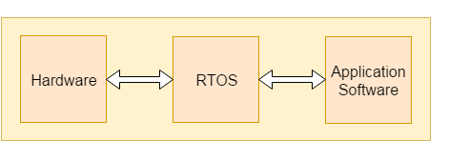
Components of Embedded system

Slide 6
Hardware: Hardware is physically used component that is physically connected with an embedded system. It comprises of microcontroller based integrated circuit, power supply, LCD display etc. Application software: Application software allows the user to perform varieties of application to be run on an embedded system by changing the code installed in an embedded system. Real Time Operating system (RTOS): RTOS supervises the way an embedded system work. It act as an interface between hardware and application software which supervises the application software and provide mechanism to let the processor run on the basis of scheduling for controlling the effect of latencies.

Slide 7
Designing of an embedded system
Basic Structure of an Embedded System

Slide 8
Sensor: Sensor used for sensing the change in environment condition and it generate the electric signal on the basis of change in environment condition. Therefore it is also called as transducers for providing electric input signal on the basis of change in environment condition. A-D Converter: An analog-to-digital converter is a device that converts analog electric input signal into its equivalent digital signal for further processing in an embedded system. Processor & ASICs: Processor used for processing the signal and data to execute desired set of instructions with high-speed of operation. Application specific integrated circuit (ASIC) is an integrated circuit designed to perform task specific operation inside an embedded system. D-A Converter: A digital-to-analog converter is a device that converts digital electric input signal into its equivalent analog signal for further processing in an embedded system. Actuators: Actuators is a comparator used for comparing the analog input signal level to desired output signal level for providing the error free output from the system.

Slide 9
Design steps required for the development of Embedded System

Slide 10
Embedded System processors
Processors are the major part in embedded systems that take response from sensors in digital form and processing of this response to produce output in real-time processing environment is performed using processors.
For an embedded system developer it is essential to have the knowledge of both microprocessors and micro controllers.
Processors inside a system:
Processors inside a system have two essential units:
Control unit: This unit in processors performed the program flow control operation inside an embedded system. The control unit also acts as a fetching unit for fetching the set of instructions stored inside a memory.
Execution unit: This unit is used for execution the various tasks inside a processors. It mainly comprises of arithmetic and logical unit (ALU) and it also include a circuit that executes the instruction sets used to perform program control operation inside processors.

Slide 11
Types of processors:
Application Specific System Processor(ASSP): ASSP is application dependent system processor used for processing signal of embedded system. Therefore for different application performing task a unique set of system processors is required.
Application Specific Instruction Processor(ASIP): ASIP is application dependent instruction processors. It is used for processing the various instruction set inside a combinational circuit of an embedded system.
General Purpose Processor (GPP): GPP is used for processing signal from input to output by controlling the operation of system bus, address bus and data bus inside an embedded system.

Slide 12
Types of general purpose processor are:
Microprocessor
Microcontroller
Digital signal processor
Analog signal processor

Slide 13
Microprocessor

Slide 14
microprocessor
A central processing unit built into a single very large scale integration(VLSI) chip is called a microprocessor. It is a general purpose device and an additional outside circuitry is added to make it work as a microcomputer.
Operations performed by microprocessor are adding, subtracting, comparing two numbers and fetching the data from memory for transferring it from one place to another.
Microprocessors is also called as Basic Input-Output system (BIOS) which used for processing the input received from sensors and produced the equivalent output from the system.

Slide 15
Let's see the basic components of microprocessor:
Arithmetic and Logic unit (ALU): ALU inside a microprocessor used to perform the arithmetic and logic operation. It performs the logic operation on the data stored inside a register.
Accumulator: It is a register inside which the intermediate arithmetic and logical operation data is stored.
Working registers: It is a storage device used to store the data inside a microprocessor in different address location.
Program counter: It is used for counting the number of program executed inside a microprocessor.
Stack pointer: Stack pointer act as a pointer to the certain address. It is a register used to store the address of the last program request made by the processor inside a stack.
Clock circuit: It is used for generate the clock pulse required as a reference signal for the microprocessor.
Interrupt circuit: It is used for generating the interrupt signal when the higher priority process required to be served first on basis of priority by microprocessor.

Slide 16
What is Microcontroller?
A microcomputer made on a single semiconductor chip is called single-chip microcomputer. Since, single chip microcomputers are generally used in control applications, they are also called microcontrollers.
Microcontroller contains all essential components of a microcomputer such as CPU, RAM, ROM/EPROM, I/O lines etc. Some single chip microcontrollers contain devices to perform specific functions such as DMA channels, A/D converter, serial port, pulse width modulation, etc.

Slide 17
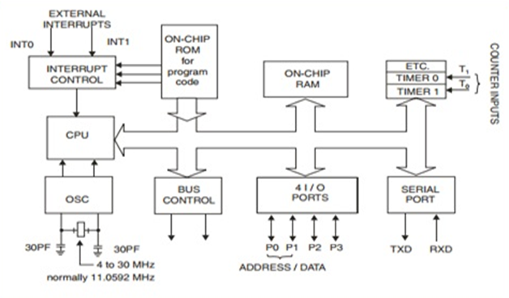
microcontroller

Slide 18
Difference between Microprocessor and Microcontroller
Microprocessors | Microcontrollers
It is used for big applications. | It is used to execute a single task within an application.
Microprocessor is the heart of computer system. | It is the heart of the embedded system.
It is just a processor. Memory and I/O components have to be having to be connected externally. | Microcontroller contains external processor along with internal memory and I/O components.
Since I/O and memory connected externally, the circuit becomes large. | Since I/O and memory present internally, the circuit is small.
Can't be used in compact systems and hence inefficient. | Can be used in compact systems and microcontroller is an efficient technique.
Cost of entire system increases. | Cost of entire system is low.
Power consumption is high. | Power consumption is low.
Most of the microprocessors do not have power saving modes. | Most of the microcontrollers have power saving mode.
Difficult to replace. | Easy to replace.
Mainly used in personal computers. | Used mainly in washing machine, MP3 players.

Slide 19
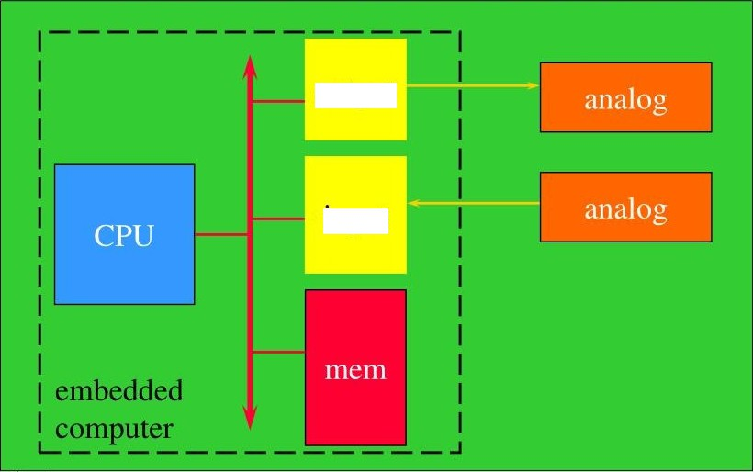
Embedding a Computer
output
input
IntroduCtIDn tO
Embedded Systems

Slide 20

General Embedded
Systems Types
General Computing ”
Applications similar to desktop computing, but in an embedded package
Video games, set- top boxes, wearable computers, automatic tellers
Control Systems
Closed- loop feedback control of real- time system
Vehicle engines, chemical processes, nuclear power, flight control
Signat Processing
Computations involving large data streams
Radar, Sonar, video compression
Communication & Networking
Switching and information transmission
Telephone system, Internet
- "
IntroduCtIDn tO
Embedded Systems

Slide 21
Types of microcontroller
Microcontroller can be categorized on the basis of architecture and service providers.
On the basis of architecture the types of microcontroller are:
On the basis of Architecture
Havard Architecture
Von Neumann Architecture
On the basis of Service Provider or Vendor the types of microcontroller are:
AVR
PIC
Hitachi
Motorola

Slide 22
Types of Microcontroller on the basis of Architect

Slide 23
1) Havard Architecture: In Havard architecture separate storage and signal buses are provided for different set of instructions and data. This architecture has the entire data storage within the CPU and there is no access available for instruction storage as data.
This architecture provides simultaneous access to an instructions and data stored inside internal buses of microcontroller.
Let's see the block diagram of Havard Architecture:

Slide 24
2) Von Neumann Architecture: This architecture of microcontroller was proposed by scientist John Von Neumann. In this architecture for both instruction and data a single data path or bus is present.
Therefore the CPU performs a single operation at a time. It either performs Read/Write operation on data, or fetches a set of instruction from memory. Hence instruction fetch and a data transfer operation cannot occur simultaneously by using a common bus.

Slide 25
Types of Microcontroller on the basis of Service Provider

Slide 26
1) AVR: AVR microcontroller is developed by Atmel service provider, AVR architecture is based on the Harvard architecture. It is based on Reduced Instruction Set Computers(RISC). AVR is not an acronym it is just a name given to the RISC architecture based microcontroller.
2) PIC: PIC microcontroller is also a Harvard architecture based controller. PIC is an acronym stands for "Peripheral Interface Controller". This type of microcontroller supports programming in C, Assembly and BASIC C.
3) Hitachi: Hitachi microcontroller belongs to H8 family of the controller. H8 is name used in large family of 8-bit, 16-bit and 32-bit microcontroller developed by Renesas Technology, founded in an early 1990s within Hitachi semiconductors.
4) Motorola: Motorola microcontroller is highly integrated microcontroller that is used for high-performance data manipulation operation. This microcontroller unit uses a System Integration Module (SIM), Time Processing Unit (TPU) and Queued Serial Module(QSM).

Slide 27
Embedded System Tools and Peripherals
Compilers and Assemblers
Compiler:
Compiler is used for converting the source code from a high-level programming language to a low-level programming language. It converts the code written in high level programming language into assembly or machine code. The main reason for conversion is to develop an executable program.
Let's see the operations performed by compiler are:
Code generation
Code optimization
Parsing
Syntax direct translation
Preprocessing
Cross-Compiler:
If a program compiled is run on a computer having different operating system and hardware configuration than the computer system on which a compiler compiled the program, that compiler is known as cross-compiler.
Decompiler:
A tool used for translating a program from a low-level language to high-level language is called a decompiler. It is used for conversion of assembly or machine code to high-level programming language.
Assembler:
Assembler is embedded system tool used for translating a computer instruction written in assembly language into a pattern of bits which is used by the computer processor for performing its basic operations. Assembler creates an object code by translating assembly language instruction into set of mnemonics for representing each low-level machine operation.

Slide 28
Embedded System Tools and Peripherals
Debugging is a tool used for reducing the number of error or bugs inside a computer program or an assembled electronic hardware.
Debugging of a compact subsystem is difficult because a small change in one subsystem can create bugs in another system. The debugging used inside embedded system differs in terms of their development time and debugging features.
Let's see the different debugging tools used in embedded system are:
Simulators:
Simulator is a tool used for simulation of an embedded system. Code tested for microcontroller unit by simulating code on the host computer. Simulator is used for model the behavior of the complete microcontroller in software.
Functions of simulators:
Let's see the functions performed by simulator are:
It defines the processing or processor device family with various version of target system.
It monitors the detailed information of a source code and symbolic arguments as the execution goes for each single step of operation.
It simulates the ports of target system for each single step of execution.
It provides the working status of RAM.
It monitors the response of system and determines the throughput.
It provides the complete meaning of the present command.
It monitors the detailed information of the simulator commands entered from the keyboard or selected from the menu.
It facilitates synchronization of internal peripherals and delays.

Slide 29
Debugging Tools in an Embedded System
Microcontroller Starter Kit:
For developing an embedded system based project a complete microcontroller starter kit is required. The major advantage of this kit over simulator is that they work in real-time operating condition. Therefore it allows the easy input/output functional verification. Consider a microcontroller starter kit consists of:-
Hardware Printed Circuit Board (PCB)
In-System Programmer (ISP)
Some embedded system tools like compiler, assembler, linker, etc
Sometimes, there is a requirement of an Integrated Development Environment (IDE)
The above component available in microcontroller starter kit is completely enough and the cheapest option available for developing simple microcontroller projects.
Emulators:
An emulator is a software program or a hardware kit which emulates the functions of one computer system into another computer system. Emulators have an ability to support closer connection to an authenticity of the digital object.
It can also be defined as the ability of a computer program in electronic device to emulate another program or device. It focusing on recreating the original computer environment and helps a user to work on any type of application or operating system.

Slide 30
Peripheral Devices in Embedded Systems
Communication of an embedded system with an outside environment is done by using different peripheral devices as a combination with microcontroller.
Let's see the different peripheral devices in embedded system are:-
Universal Serial Bus (USB)
Networks like Ethernet, Local Area Network(LAN) etc
Multi Media Cards (SD Cards, Flash memory, etc)
Serial Communication Interface (SCI) like RS-232, RS-485, RS-422, etc
Synchronous Serial Communication Interface like SPI, SSC and ESSI
Digital to Analog/ Analog to Digital (DAC/ADC)
General Purpose Input/Output (GPIO)
Debugging like In System Programming (ISP), In Circuit Serial Programming (ICSP), BDM Port, etc

Slide 31
Criteria for Choosing Microcontroller
Choosing a microcontroller is essential process in designing of embedded system. While selecting a microcontroller, make sure that it meets the system need and it must be cost effective. We need to decide whether an 8-bit, 16-bit or 32-bit microcontroller is best suitable for the computing needs of a task.
In addition to above, the following points need to be kept in mind while selecting a microcontroller:-
Speed: The operational speed of the microcontroller or the highest speed microcontroller can support.
Packaging: Packaging is important for improving the assembling, space and prototyping of an end-product.
RAM and ROM: On the basis of operation of embedded system and memory need for storage data and programs the type of microcontroller required for designing system is decided.
Count of I/O pins: The number of input and output devices connected with the system plays an essential role in choosing the type of microcontroller.
Cost per unit: It is important in terms of final cost of the product in which the microcontroller is to be used.
Power consumption: Power consumption plays an important role for maintaining the efficiency of an embedded system

Slide 32
MICROCONTROLLERS BY INTEL
Device | RAM (bytes) | ROM | Speed | Timers | Ports | Picture
8031 | 128 | - | 12MHz | 2 | 4x8
8032 | 256 | - | 12MHz | 2 | 4x8
8044* | 192 | 4096 | 12MHz | 2 | 4x8
8051 | 128 | 4096 | 12MHz | 2 | 4x8
8052 | 256 | 8192 | 24MHz | 2 | 4x8
8054 | 256 | 16K | 24MHz | 3 | 4x8
8058 | 256 | 32K | 33MHz | 3 | 4x8
MCS-251
8x251SA | 1k | 8k | 16MHz | 3 | 32
8x251SB | 1k | 16k | 16MHz | 3 | 32
8x251SP | 512 | 8k | 16MHz | 3 | 32
8x251SQ | 512 | 16k | 16MHz | 3 | 32
8x251TB | 1K | 16k | 24MHz | 3 | 32
8251TQ | 512 | - | 24MHz | 3 | 32
USB Equipped MCS-251
80930Ax | 512-1024 | - | 12MHz
83930Ax

Slide 33
8051 Microcontroller
The 8051 microcontroller was invented in 1980's by Intel. Its foundation is based on Harvard architecture and this microcontroller was developed principally for bringing it to be used in Embedded Systems.
At first it was created by using NMOS technology but the use of NMOS consumed more power to work therefore Intel re-launch the microcontroller 8051 using CMOS technology and new edition came up with edition of letter 'C' in the title name, therefore the new modified version of microcontroller is called by name 80C51.
The 8051 microcontroller programming is performed in embedded C language using Keil software.

Slide 34
Features of 8051 Microcontroller:
It having four register banks
64K bytes on-chip programmable memory (ROM)
128 bytes on-chip data memory (RAM)
Address bus is 16-bit unidirectional
Data bus is 8-bit bidirectional
128 user defined flags
16 bit timers
32 general purpose registers each of 8-bit
8051 microcontroller offers a number of special features such as ADC, UARTs, Op-amp, etc.

Slide 35
Application of 8051 Microcontroller
Energy Management : In energy management system the measuring device is used for calculating the energy consumption in industrialized and domestic applications. These systems are manufactured by integrating the microcontrollers inside their architecture configuration.
Automobiles : Microcontroller 8051 is to be used for providing automobile solutions. They are largely be used in hybrid motor vehicles to control engine variations.
Touch screens: The advanced degree of microcontroller integrate the touch sensing ability within their design .Transportable devices such as cell phones, media players and gaming devices are some example of microcontroller integrated with touch screens.
Medical Devices: Microcontroller is used in various medical devices such as glucose and blood pressure measurement machine for monitoring and measuring the exact result in real-time computational environment.

Slide 36
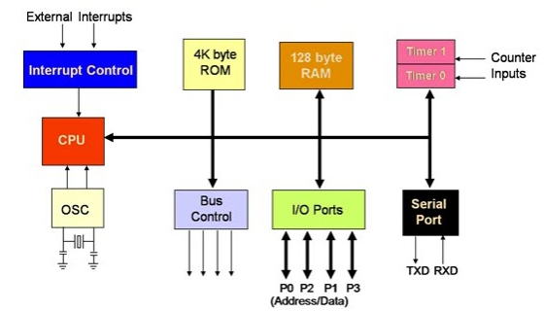
8051 MC ARCHITECTURE

Slide 37
8051 Microcontroller Architecture
CPU (Central Processing Unit): CPU act as a mind of any processing machine. It synchronizes and manages all processes that are carried out in microcontroller. User has no power to control the functioning of CPU. It interprets the program stored in ROM and carries out from storage and then performs it projected duty. CPU manage the different types of registers available in 8051 microcontroller.
Interrupts: Interrupts is a sub-routine call that given by the microcontroller when some other program with high priority is request for acquiring the system buses the n interrupts occur in current running program.
Interrupts provide a method to postpone or delay the current process, performs a sub-routine task and then restart the standard program again.
Types of interrupt in 8051 Microcontroller:
Let's see the five sources of interrupts in 8051 Microcontroller:
Timer 0 overflow interrupt - TF0
Timer 1 overflow interrupt - TF1
External hardware interrupt - INT0
External hardware interrupt - INT1
Serial communication interrupt - RI/TI

Slide 38
Memory: For operation Micro-controller required a program. This program guides the microcontroller to perform the specific tasks. This program installed in microcontroller required some on chip memory for the storage of the program.
Microcontroller also required memory for storage of data and operands for the short duration. In microcontroller 8051 there is code or program memory of 4 KB that is it has 4 KB ROM and it also comprise of data memory (RAM) of 128 bytes.
Bus : Bus is a group of wires which uses as a communication canal or acts as means of data transfer. The different bus configuration includes 8, 16 or more cables. Therefore, a bus can bear 8 bits, 16 bits all together.
Types of buses in 8051 Microcontroller:
Let's see the two types of bus used in 8051 microcontroller:
Address Bus: 8051 microcontrollers is consisting of 16 bit address bus. It is generally be used for transferring the data from Central Processing Unit to Memory.
Data bus: 8051 microcontroller is consisting of 8 bits data bus. It is generally be used for transferring the data from one peripherals position to other peripherals.
Oscillator: As the microcontroller is digital circuit therefore it needs timer for their operation. To perform timer operation inside microcontroller it required externally connected or on-chip oscillator. Microcontroller is used inside an embedded system for managing the function of devices. Therefore, 8051 uses the two 16 bit counters and timers. For the operation of this timers and counters the oscillator is used inside microcontroller.

Slide 39
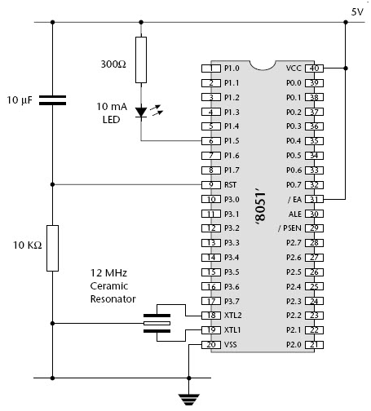
8051 Microcontroller Pin Diagram
Let's see the 40 pin Dual Inline Package (DIP) of microcontroller integrated circuit with externally connected power supply and oscillator.

Slide 40
PIN DESCRIPTION
Pins 1-8: These pins belongs to Port 1 of microcontroller. Port 1 is used as domestically pulled up, quasi bi directional input/output port.
Pin 9: It is a RESET pin which is utilized to set the microcontroller 8051 to its primary value. During the beginning of an application the RESET pin is to be set elevated for two machine rotations.
Pins 10-17: These pins belong to Port 3 of microcontroller. Port 3 can be used for number of functions such as timer input, interrupts, serial communication indicator for transmitting (TxD) and receiving (RxD). It is also known as domestic pull up port with quasi bi direction port embedded within.
Pins 18 and 19: These pins are generally be used for interfacing outer crystal oscillator with given system clock.
Pin 20: This pin titled as V_{ss}. It symbolizes ground voltage or 0 V is connected to this pin of microcontroller.

Slide 41
Pin 21-28: These pins belong to port 2 of microcontroller. Port 2 can be used as Input/output port, senior order address bus are multiplexed with this quasi bi directional port.
Pin 29: This pin belongs to Program Store Enable or PSEN. It is used for interpreting the sign from outer program memory.
Pin 30: This pin belongs to External Access or EA input is used for permit or prohibits outer memory interfacing. If there is no outer memory need, this pin is set to high by linking it with supply voltage .
Pin 31: This pin belongs to Address Latch Enable or ALE is used for de-multiplexing the address data indication of port 0 for outer memory interfacing.
Pin 32-39: These pins belong to Port 0 of the microcontroller. Port 0 can be used as input/output port, lower order address and data bus signals are multiplexed with this port. This pin act as bi directional Input/output port and outer connected pull up resistors are necessary for utilizing these ports as Input/output.
Pin 40: This pin is used to provide power supply to the circuit.

Slide 42
Embedded C Programming with Keil Language
Embedded C is most popular programming language in software field for developing electronic gadgets. Each processor used in electronic system is associated with embedded software.
Embedded C programming plays a key role in performing specific function by the processor. In day-to-day life we used many electronic devices such as mobile phone, washing machine, digital camera, etc. These all device working is based on microcontroller that are programmed by embedded C.

Slide 43
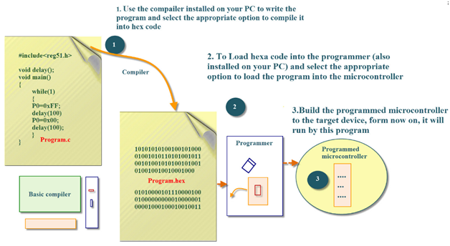
BLOCK DIAGRAM

Slide 44
In embedded system programming C code is preferred over other language. Due to the following reasons:
Easy to understand
High Reliability
Portability
Scalability

Slide 45
Embedded System Programming:
Basic Declaration
Let's see the block diagram of Embedded C Programming development:

Slide 46
Function is a collection of statements that is used for performing a specific task and a collection of one or more functions is called a programming language. Every language is consisting of basic elements and grammatical rules. The C language programming is designed for function with variables, character set, data types, keywords, expression and so on are used for writing a C program.
The extension in C language is known as embedded C programming language. As compared to above the embedded programming in C is also have some additional features like data types, keywords and header file etc is represented by

Slide 47
Basic Embedded C Programming Steps
Let's see the block diagram representation of Embedded C Programming Steps:
The microcontroller programming is different for each type of operating system. Even though there are many operating system are exist such as Windows, Linux, RTOS, etc but RTOS has several advantage for embedded system development.

Slide 48
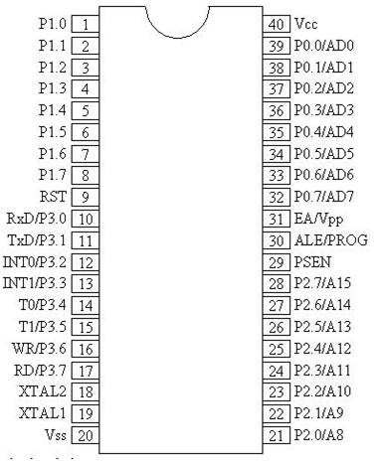
Embedded System I/O Programming
In 8051 Microcontroller, I/O operations are performed by using four ports and 40 pins. I/O operation port uses 32 pins with each port has 8 pins. The remaining 8-pins are used for providing
Let's see the 40-Pin Plastic Dual Inline Package (PDIP) integrated circuit of microcontroller:
Note - In DIP structure of microcontroller we can recognize the first and last pin by using the cut present at middle of IC this cut is called as Notch of microcontroller. The first pin is present at left side of notch and last pin is present at right side of notch.

Slide 49
I/O Ports and their Functions:
In microcontroller there are four Input/output ports P0, P1, P2, and P3, each port is 8-bit port having 8 pins each. During RESET, all the ports are used as input ports. When the port gets first 0, then it becomes an output port. For reconfigure it as an input, the high signal (1) must be sent to a port.
Port 0 (Pin No 32 - Pin No 39):
Port 0 contains 8 pins. It can be used as input or output. In general we connect P0 with 10K-ohm pull-up resistors for using it as an input or output port being an open drain.
It is also referred as AD0-AD7, which allowing it to be used as both address and data transfer port. When we want to excess the external ROM, then P0 is used as both Data and Address Bus.
Address Latch Enable (ALE) Pin no 31 indicates if PO is used as address or data.
When ALE=0 then it provides data D0-D7.
When ALE=1 then it provides address A0-A7.

Slide 50
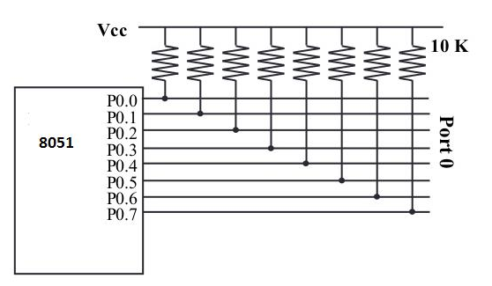
Let's see the structure of port 0 with externally connected pull up resistor:
Let's see an assembly language code for making the Port 0 to be worked as an input:-
MOV A, #FFH; (comments: A=FFH i.e. A=1111 1111)
MOV P0, A; (Port 0 all pin have 1's so that it work as Input)

Slide 51
Port 1 (Pin No 1-Pin No 8):
It is also an 8-bit Port and can be worked as either input or output. It doesn't require external connected pull-up resistors because they are already present internally. Upon reset, Port 1 worked as an input port.
If port 1 is configured as an output port, then to use port 1 as input port again, we write 1 to all bits of port 1 as shown in the below code:-
MOV A, #FFH ; Value of Accumulator register A=FF hex
MOV P1, A ; Port 1 worked as an input port
MOV A, P1 ; get data from P1
MOV R5, A ; save it in Register R5
ACALL DELAY ; wait
MOV A, P1 ; get another data from P1
MOV R6, A ; save it in R6
ACALL DELAY ; wait
MOV A, P1 ; get data from P1
MOV R7, A ; save it in R7

Slide 52
Port 2 (Pin No 21-Pin No 28):
Port 2 uses a total of 8 pins and it can also be used as input and output operation. Same as Port 1, P2 also not require external pull- up resistors. Port 2 can be used along with P0 to provide 16-bit address for an external memory. Therefore it is designated as (A0-A7), as shown in pin diagram.
If Port 2 is configured as an output port, then for using it as an input port again we write 1 to all bits of port 2 as shown in the below code:-
MOV A, #FFH ; Value of Accumulator register A=FF hex
MOV P2, A ; Port 2 worked as an input port
BACK:
MOV A, P1 ; get data from P2
MOV P1, A ; save it in Port 1
SJMP BACK ; Keep doing that

Slide 53
Port 3 (Pin No 10-Pin No 17):
Port 3 is also of 8 bits and it can be used as Input/output. This port provides some important signals.
P3.1 and P3.0 are RxD (Receiver) and TxD (Transmitter) respectively and it is collectively used for serial communication.
P3.3 and P3.2 pins are used as external interrupts.
P3.5 and P3.4 are used as timers T1 and T0 respectively.
P3.6 and P3.7 are Write (WR) and Read (RD) pins.
Let's see the Port 3 table showing an individual pin function:
Pin | Function | P3 Bit
10 | Receiver (RxD) | P3.0
11 | Transmitter (TxD) | P3.1<
12 | Complement of INT 0 | P3.2<
13 | INT 1 | P3.3<
14 | Timer 0(TO) | P3.4<
15 | Timer 1(T1) | P3.5<
16 | Write (WR) | P3.6<
17 | Complement of read (RD) | P3.7<

Slide 54
I/O Ports and Bit Addressability:
It is a mostly used feature of 8051 while writing code for 8051. Sometimes there is a need to use only 1 or 2 bits of the port instead of using entire 8-bits. 8051 microcontroller provides the feature to use each bit of the ports.
While using a port in a single-bit manner, we provide the syntax "SETB X.Y", where X is the port number varies from 0 to 3, and Y is a bit number varies from 0 to 7.
For example: - "SETB P1.3" sets high bit 3 of port 1.
Let's see an assembly code for toggling the bit of P1.5 continuously:
AGAIN:
SETB P1.5
ACALL DELAY
CLR P1.5
ACALL DELAY
SJMP AGAIN

Slide 55
Single Bit Instruction:
INSTRUCTION | FUNCTION
CLR bit | Clear the bit (bit=0)
CPL bit | Complement the bit (bit=NOT bit)
SETB bit | Set the bit (bit = 1)
JB bit, target | Jump to target if bit = 1 (jump if bit)
JBC bit, target | Jump to target if bit = 1, clear bit (jump if bit, then clear)
JNB bit, target | Jump to target if bit = 0 (jump if no bit)

Slide 56
8051 Instruction Set
An instruction is a command given to the microcontroller for performing a specified operation on presented data. The instruction set of microcontroller is a collection of instructions that the microcontroller is designed to execute.

Slide 57
Data moving or handling Instructions:
Mnemonics | Operational descriptions | Addressing modes | No. of cycles used | No. of bytes occupied
Mov a,#num | This instruction Copy the immediate data number in to acc | immediate | 1 | 2
Mov Rx,a | This instruction Copy the data from acc to Rx | register | 1 | 1
Mov a,Rx | This instruction Copy the data from Rx to acc | register | 1 | 1
Mov Rx,#num | This instruction Copy the immediate data num in to Rx | immediate | 1 | 2
Mov a,add | This instruction Copy the data from direct address location add to acc | direct | 1 | 2
Mov add,a | This instruction Copy the data from acc to direct address add | direct | 1 | 2
Mov add,#num | This instruction Copy the immediate data num in to direct address | direct | 2 | 3
Mov add1,add2 | This instruction Copy the data from add2 to add1 | direct | 2 | 3

Slide 58
Mov Rx,add | This instruction Copy the data from direct | direct | 2 | 2
Mov add,Rx | This instruction Copy the data from Rx to direct address add | direct | 2 | 2
Mov @Rp,a | This instruction Copy the data in acc to address in Rp | Indirect | 1 | 2
Mov a,@Rp | This instruction Copy the data that is at address in Rp to acc | Indirect | 1 | 1
Mov add,@Rp | This instruction Copy the data that is at address in Rp to add | Indirect | 2 | 2
Mov @Rp,add | This instruction Copy the data in add to address in Rp | Indirect | 2 | 2
Mov @Rp,#num | This instruction Copy the immediate byte num to the address in Rp | Indirect | 1 | 2
Movx a,@Rp | This instruction Copy the content of external add in Rp to acc | Indirect | 2 | 1
Movx a,@DPTR | This instruction Copy the content of external add in DPTR to acc | Indirect | 2 | 1
Movx @Rp,a | This instruction Copy the content of acc to the external add in Rp | Indirect | 2 | 1

Slide 59
Movx @DPTR,a | This instruction Copy the content of acc to the external add in DPTR | Indirect | 2 | 1
Movc a,@a+DPTR | In this the address of instruction is formed by adding acc and DPTR and their content is copied to acc | indirect | 2 | 1
Movc a, @a+PC | In this the address of instruction is formed by adding acc and PC and its content is copied to acc | indirect | 2 | 1
Push add | In this instruction Increment Stack Pointer (SP) and copy the data from source add to internal RAM address contained in SP | Direct | 2 | 2
Pop add | This instruction copy the data from an internal RAM address contained in SP to destination add and decrement SP | direct | 2 | 2
Xch a, Rx | This instruction Exchange the data between acc and Rx | Register | 1 | 1
Xch a, add | This instruction Exchange the data between acc and given add | Direct | 1 | 2
Xch a,@Rp | This instruction Exchange the data between acc and address in Rp | Indirect | 1 | 1
Xchd a, @Rp | This instruction Exchange only lower nibble of acc and address in Rp | indirect | 1 | 1

Slide 60
What is a Microprocessor?
Computer's Central Processing Unit (CPU) built on a single Integrated Circuit (IC) is called a microprocessor.
A digital computer with one microprocessor which acts as a CPU is called microcomputer.
It is a programmable, multipurpose, clock -driven, register-based electronic device that reads binary instructions from a storage device called memory, accepts binary data as input and processes data according to those instructions and provides results as output.
The microprocessor contains millions of tiny components like transistors, registers, and diodes that work together.

Slide 61
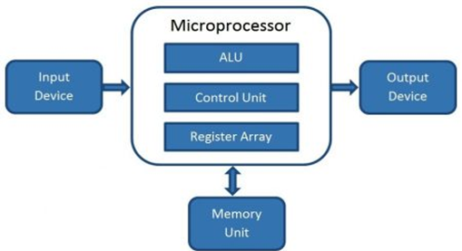
Block Diagram of a Microcomputer
A microprocessor consists of an ALU, control unit and register array. Where ALU performs arithmetic and logical operations on the data received from an input device or memory. Control unit controls the instructions and flow of data within the computer. And, register array consists of registers identified by letters like B, C, D, E, H, L, a

Slide 62
Evolution of Microprocessors
We can categorize the microprocessor according to the generations or according to the size of the microprocessor:
First Generation (4 - bit Microprocessors)
The first generation microprocessors were introduced in the year 1971-1972 by Intel Corporation. It was named Intel 4004 since it was a 4-bit processor.
It was a processor on a single chip. It could perform simple arithmetic and logical operations such as addition, subtraction, Boolean OR and Boolean AND.
I had a control unit capable of performing control functions like fetching an instruction from storage memory, decoding it, and then generating control pulses to execute it.
Second Generation (8 - bit Microprocessor)
The second generation microprocessors were introduced in 1973 again by Intel. It was a first 8 - bit microprocessor which could perform arithmetic and logic operations on 8-bit words. It was Intel 8008, and another improved version was Intel 8088.
Third Generation (16 - bit Microprocessor)
The third generation microprocessors, introduced in 1978 were represented by Intel's 8086, Zilog Z800 and 80286, which were 16 - bit processors with a performance like minicomputers.

Slide 63
Fourth Generation (32 - bit Microprocessors)
Several different companies introduced the 32-bit microprocessors, but the most popular one is the Intel 80386.
Fifth Generation (64 - bit Microprocessors)
From 1995 to now we are in the fifth generation. After 80856, Intel came out with a new processor namely Pentium processor followed by Pentium Pro CPU, which allows multiple CPUs in a single system to achieve multiprocessing.
Other improved 64-bit processors are Celeron, Dual, Quad, Octa Core processors.

Slide 64
Table: Important Intel Microprocessors
Microprocessor | Year of Invention | Word Length | Memory addressing Capacity | Pins | Clock | Remarks
4004 | 1971 | 4-bit | 1 KB | 16 | 750 KHz | First Microprocessor
8085 | 1976 | 8-bit | 64 KB | 40 | 3-6 MHz | Popular 8-bit Microprocessor
8086 | 1978 | 16-bit | 1MB | 40 | 5-8 MHz | Widely used in PC/XT
80286 | 1982 | 16-bit | 16MB real, 4 GB virtual | 68 | 6-12.5 MHz | Widely used in PC/AT
80386 | 1985 | 32-bit | 4GB real, 64TB virtual | 132 14X14 PGA | 20-33 MHz | Contains MMU on chip
80486 | 1989 | 32-bit | 4GB real, 64TB virtual | 168 17X17 PGA | 25-100 MHz | Contains MMU, cache and FPU, 1.2 million transistors

Slide 65
Pentium | 1993 | 32-bit | 4GB real,32-bit address,64-bit data bus | 237 PGA | 60-200 | Contains 2 ALUs,2 Caches, FPU, 3.3 Million transistors, 3.3 V, 7.5 million transistors
Pentium Pro | 1995 | 32-bit | 64GB real, 36-bit address bus | 387 PGA | 150-200 MHz | It is a data flow processor. It contains second level cache also,3.3 V
Pentium II | 1997 | 32-bit | - | - | 233-400 MHz | All features Pentium pro plus MMX technology,3.3 V, 7.5 million transistors
Pentium III | 1999 | 32-bit | 64GB | 370 PGA | 600-1.3 MHz | Improved version of Pentium II; 70 new SIMD instructions
Pentium 4 | 2000 | 32-bit | 64GB | 423 PGA | 600-1.3 GHz | Improved version of Pentium III
Itanium | 2001 | 64-bit | 64 address lines | 423 PGA | 733 MHz-1.3 GHz | 64-bit EPIC Processor

Slide 66
Where,
PGA - Pin Grid Array
MMX - MultiMedia eXtensions
EPIC - Explicitly Parallel Instruction Computing
SIMD - Single Instruction Multiple Data
ALU - Arithmetic and Logic Unit
MMU - Memory Management Unit
FPU - Floating Point Unit

Slide 67
Basic Terms used in Microprocessor
Instruction Set - The group of commands that the microprocessor can understand is called Instruction set. It is an interface between hardware and software.
Bus - Set of conductors intended to transmit data, address or control information to different elements in a microprocessor. A microprocessor will have three types of buses, i.e., data bus, address bus, and control bus.
IPC (Instructions Per Cycle) - It is a measure of how many instructions a CPU is capable of executing in a single clock.
Clock Speed - It is the number of operations per second the processor can perform. It can be expressed in megahertz (MHz) or gigahertz (GHz). It is also called the Clock Rate.
Bandwidth - The number of bits processed in a single instruction is called Bandwidth.
Word Length - The number of bits the processor can process at a time is called the word length of the processor. 8-bit Microprocessor may process 8 -bit data at a time. The range of word length is from 4 bits to 64 bits depending upon the type of the microcomputer.
Data Types - The microprocessor supports multiple data type formats like binary, ASCII, signed and unsigned numbers.

Slide 68
Working of Microprocessor
The microprocessor follows a sequence to execute the instruction: Fetch, Decode, and then Execute.
Initially, the instructions are stored in the storage memory of the computer in sequential order.
The microprocessor fetches those instructions from the stored area (memory), then decodes it and executes those instructions till STOP instruction is met.
Then, it sends the result in binary form to the output port. Between these processes, the register stores the temporary data and ALU (Arithmetic and Logic Unit) performs the computing functions.

Slide 69
Features of Microprocessor
Low Cost - Due to integrated circuit technology microprocessors are available at very low cost. It will reduce the cost of a computer system.
High Speed - Due to the technology involved in it, the microprocessor can work at very high speed. It can execute millions of instructions per second.
Small Size - A microprocessor is fabricated in a very less footprint due to very large scale and ultra large scale integration technology. Because of this, the size of the computer system is reduced.
Versatile - The same chip can be used for several applications, therefore, microprocessors are versatile.
Low Power Consumption - Microprocessors are using metal oxide semiconductor technology, which consumes less power.
Less Heat Generation - Microprocessors uses semiconductor technology which will not emit much heat as compared to vacuum tube devices.
Reliable - Since microprocessors use semiconductor technology, therefore, the failure rate is very less. Hence it is very reliable.
Portable - Due to the small size and low power consumption microprocessors are portable.

Slide 70
Types of Microprocessors
Vector Processors
A vector processor is designed for vector computations. A vector is an array of operands of the same type. Consider the following vectors:
Vector A (a₁, a₂, a₃, ......., a_{n}) Vector B (b₁, b₂, b₃,......., b_{n}) Vector C = Vector A + Vector B = C(c₁, c₂, c₃, .......,c_{n}), where c₁ = a₁+ b₁, c₂ = a₂ + b₂, .....,C_{n}= a_{n} + b_{n}.
A vector processor adds all the elements of vector A and Vector B using a single vector instruction with hardware approach.
Examples of vector processors are:
DEC's VAX 9000,
IBM 390/VF,
CRAY Research Y-MP family,
Hitachi's S-810/20, etc.

Slide 71
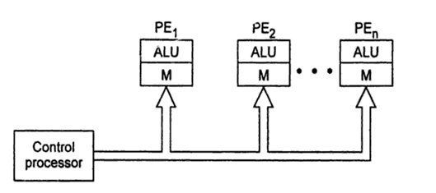
Array Processors or SIMD Processors
Array processors are also designed for vector computations. The difference between an array processor and a vector processor is that a vector processor uses multiple vector pipelines whereas an array processor employs a number of processing elements to operate in parallel.
An array processor contains multiple numbers of ALUs. Each ALU is provided with the local memory. The ALU together with the local memory is called a Processing Element (PE). An array processor is a SIMD (Single Instruction Multiple Data) processor. Thus using a single instruction, the same operation can be performed on an array of data which makes it suitable for vector computations.

Slide 72
Scalar and Superscalar Processors
A processor that executes scalar data is called scalar processor. The simplest scalar processor makes processing of only integer instruction using fixed-points operands. A powerful scalar processor makes processing of both integer as well floating- point numbers. It contains an integer ALU and a Floating Point Unit (FPU) on the same CPU chip.
A scalar processor may be RISC processor or CISC processor.
Examples of CISC processors are:
Intel 386, 486; Motorola's 68030, 68040; etc.
Examples of RISC scalar processors are:
Intel i860, Motorola MC8810, SUN's SPARC CY7C601, etc.
A superscalar processor has multiple pipelines and executes more than one instruction per clock cycle.
Examples of superscalar processors are:
Pentium, Pentium Pro, Pentium II, Pentium III, etc.

Slide 73
RISC and CISC Processors
RISC stands for Reduced Instruction Set Computer and
CISC stands for Complex Instruction Set Computer.
There are two approaches of the design of the control unit of a microprocessor i.e.-
Hardware approach and
Software approach.
RISC Processors:- To execute an instruction, a number of steps are required. By the control unit of the processor, a number of control signals are generated for each step. To execute each instruction, if there is a separate electronic circuitry in the control unit, which produces all the necessary signals, this approach of the design of the control section of the processor is called RISC design. It is hardware approach. It is also called hard-wired approach.
Examples of RISC processors are:
DEC's Alpha 21064, 21164 and 21264 processors;
SUN's SPARC and ULTRA SPARC;
PowerPC processors etc.
CISC Processors:- If the control unit contains a number of micro electronic circuitry to generate a set of control signals and each micro circuitry is activated by a microcode, this design approach is called CISC design. This is a software approach of designing a control unit of the processor.
Examples of CISC processors are:
Intel 386, 486;
Pentium Pro, Pentium, Pentium II, Pentium III, Pentium 4;
Motorola's 68000, 68020, 68030, 68040, etc.

Slide 74
Difference between RISC and CISC
S.No. | RISC | CISC
1. | Simple instruction set | Complex instruction set
2. | Consists of Large number of registers. | Less number of registers
3. | Larger Program | Smaller program
4. | Simple processor circuitry (small number of transistors) | Complex processor circuitry (more number of transistors)
5. | More RAM usage | Little Ram usage
6. | Simple addressing modes | Variety of addressing modes
7. | Fixed length instructions | Variable length instructions
8. | Fixed number of clock cycles for executing one instruction | Variable number of clock cycles for each instructions

Slide 75
Digital Signal Processors (DSP)
DSP microprocessors specifically designed to process signals. They receive some digitized signal information, perform some mathematical operations on the information and give the result to an output device. They implement integration, differentiation, complex fast Fourier transform, etc. using hardware.
Examples of digital signal processors are:
Texas instruments' TMS 320C25,
Motorola 56000,
National LM 32900,
Fujitsu MBB 8764, etc.

Slide 76
Symbolic Processors
Symbolic processors are designed for expert system, machine intelligence, knowledge based system, pattern-recognition, text retrieval, etc.
The basic operations which are performed for artificial intelligence are:
Logic interference, compare, search, pattern matching, filtering, unification, retrieval, reasoning, etc. This type of processing does not require floating point operations. Symbolic processors are also called LISP processors or PROLOG processors.

Slide 77
Bit-Slice Processors
The processor of desired word length is developed using the building blocks. The basic building block is called Bit-Slice where the building blocks include 4-bit ALUs, micro programs sequencers, carry look-ahead generators, etc. The word 'slice' was used because the desired number of ALUs and other components were used to build an 8-bit, 16-bit or 32-bit CPU.
Examples of Bit-Slice Processors were:
AMD-2900, AMD 2909, AMD 2910, AMD 29300 series,
Texas instrument's SN-74AS88XX series, etc.

Slide 78
Transputers
In a multiprocessor system, a transputer is a specially designed microprocessor to operate as a component processor.
Transputers were introduced in late 1980's. They were built on VLSI chip and contained a processor, memory and communication links. The communication link was to provide point-to-point connection between transputers.
A transputer contains FPU, on-chip RAM, high-speed serial link, etc.
Examples of transputers are:
INMOS T414, INMOS T800, etc.
Where, T414 was a 32-bit processor with 2 KB memory. The T800 was FPU version of 32-bit transputer with 4 KB memory.

Slide 79
Graphic Processors
Graphics Processors are specially designed processors for graphics. Intel has developed Intel 740-3D graphics chip. It is optimized for Pentium II PCs, using a hyper pipelined 3D architecture with additional 2D acceleration. Like most 3D graphics chips, the I-740 will be marketed in performance, not the main stream category. It is designed mostly for such heavy multimedia uses as games and movies.
Examples of Graphic Processors are:
Intel 82786 graphics coprocessor
IBM's 8514/A,
Texas Instruments' TMS34010 and TMS34020,
Intel i860 and Intel i750, etc.

Slide 80
Microprocessor Architecture
The microprocessor is the CPU (Central Processing Unit) of a computer. It is the heart of the computer. Here, we will describe Intel 8085 as it is one of the most popular 8-bit microprocessor.
Intel 8085
Intel 8085 is an 8-bit, NMOS microprocessor designed by Intel in 1977.
It has following configuration:
It is a 40 pin I.C. package fabricated on a single LSI chip.
The Intel 8085 uses a single +5Vd.c. supply for its operation.
Intel 8085?s clock speed is about 3 MHz; the clock cycle is of 320ns.
8 ?bit data bus.
Address bus is of 16-bit, which can address up to 64KB
16-bit stack pointer
16 bit PC (Program Counter)
Six 8-bit registers are arranged in pairs :BC, DE, HL
Intel 8085 is used in mobile phones, microwave ovens, washing machines etc

Slide 81
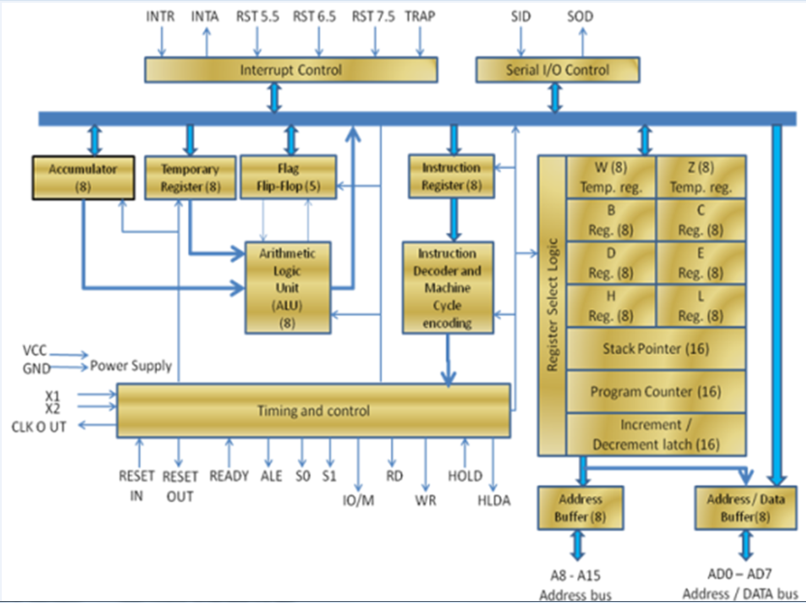
block diagram of Intel 8085:

Slide 82
ALU
The Arithmetic and Logic Unit, ALU performs the arithmetic and logical operations:
Addition
Subtraction
Logical AND
Logical OR
Logical EXCLUSIVE OR
Complement (Logical NOT)
Increment (add 1)
Decrement (subtract 1)
Left shift, Rotate left, Rotate right
Clear, etc.

Slide 83
Timing and Control Unit
The timing and control unit is the section of the CPU.
It is used to generate timing and control signals which are necessary for the execution of instructions.
It is used to control data flow between CPU and peripherals (including memory).
It is used to provide status, control and timing signals which are required for the operation of memory and I/O devices.
It is used to control the entire operations of the microprocessor and peripherals connected to it.
Thus we can see that the control unit of the CPU acts as the brain of the computer system.

Slide 84
Registers
Registers are used for temporary storage and manipulation of data and instructions by the microprocessor. Data remain in the registers till they are sent to the I/O devices or memory. Intel 8085 microprocessor has the following registers:
One 8-bit accumulator (ACC) i.e. register A
Six general purpose registers of 8-bit, these are B,C, D, E, H and L
One 16-bit stack pointer, SP
One 16-bit Program Counter, PC
Instruction register
Temporary register
In addition to the above mentioned registers the 8085 microprocessor contains a set of five flip-flops which serve as flags (or status flags).
A flag is a flip-flop which indicates some conditions which arises after the execution of an arithmetic or logical instruction.

Slide 85
Accumulator (ACC): The accumulator is an 8-bit register associated with the ALU. The register 'A' is an accumulator in the 8085. It is used to hold one of the operands of an arithmetic and logical operation. The final result of an arithmetic or logical operation is also placed in the accumulator.
General-Purpose Registers: The 8085 microprocessor contains six 8-bit general purpose registers. They are: B, D, C, E, H and L register. To hold data of 16-bit a combination of two 8-bit registers can be employed. The combination of two 8-bit registers is called register pair. The valid register pairs in the 8085 are: D-E, B-C and H-L. The H-L pair is used to act as a memory pointer.
Program Counter (PC): It is a 16-bit special purpose register. It is used to hold the address of memory of the next instruction to be executed. It keeps the track of the instruction in a program while they are being executed. The microprocessor increments the content of the next program counter during the execution of an instruction so that at the end of the execution of an instruction it points to the next instruction?s address in the program.

Slide 86
4. Stack Pointer (SP): It is a 16-bit special function register used as memory pointer. A stack is nothing but a portion of RAM. In the stack, the contents of only those registers are saved, which are needed in the later part of the program. The stack pointer (SP) controls the addressing of the stack. The Stack Pointer contains the address of the top element of data stored in the stack.
5. Instruction Register: The instruction register holds the opcode (operation code or instruction code) of the instruction which is being decoded and executed.
6.Temporary Register: It is an 8-bit register associated with the ALU. It holds data during an arithmetic/logical operation. It is used by the microprocessor. It is not accessible to programmer.

Slide 87
7. Flags: The Intel 8085 microprocessor contains five flip-flops to serve as a status flags. The flip-flops are reset or set according to the conditions which arise during an arithmetic or logical operation.
The five status flags of Intel 8085 are:
Carry Flag (CS)
Parity Flag (P)
Auxiliary Carry Flag (AC)
Zero Flag(Z)
Sign Flag(S)
If a flip-flop for a particular flag is set, then it indicates 1. When it is reset, it indicates 0.

Slide 88
Data and Address Bus
The Intel 8085 is an 8-bit microprocessor. Its data bus is 8-bit wide and therefore, 8 bits of data can be transmitted in parallel from or to the microprocessor.
The Intel 8085 requires an address bus of 16-bit wide as the memory addresses are of 16-bits.
The 8 most significant bits of the address are transmitted by the address bus, A-bus (pins A₈ ? A₁₅).
The 8 least significant bits of the address are transmitted by data/address bus, AD-bus (pins AD₀ ? AD₇).

Slide 89
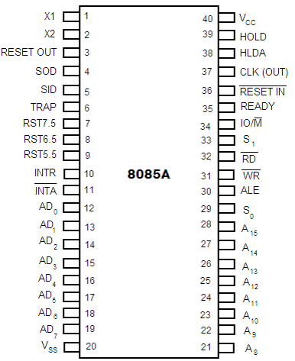
Pin Configuration

Slide 90
The descriptions of various pins are as follows:
Address Bus and Data Bus
A₈ ? A₁₅ (Output): These are address bus and are used for the most significant bits of the memory address or 8-bits of I/O address.
AD₀ ? AD₇ (Input/output): These are time multiplexed address/data bus i.e. they serve dual purpose. They are used for the least significant 8 bits of the memory address or I/O address during the first cycle. Again they are used for data during 2nd and 3rd clock cycles.
Control and Status Signals
ALE (Output): ALE stands for Address Latch Enable signal. ALE goes high during first clock cycle of a machine cycle and enables the lower 8-bits of the address to be latched either into the memory or external latch.
IO/M (Output): It is a status signal which distinguishes whether the address is for memory or I/O device.
S₀, S₁ (Output): These are status signals sent by the microprocessors to distinguish the various types of operation given in table below:

Slide 91
Status codes for Intel 8085
RD (Output): RD is a signal to control READ operation. When it goes low, the selected I/O device or memory is read.
WR (Output): WR is a signal to control WRITE operation. When it goes low, the data bus' data is written into the selected memory or I/O location.
READY (Input): It is used by the microprocessor to sense whether a peripheral is ready to transfer a data or not. If READY is high, the peripheral is ready. If it is low the micro processor waits till it goes high.
S₁ | S₀ | Operations
0 | 0 | HALT
0 | 1 | WRITE
1 | 0 | READ
1 | 1 | FETCH

Slide 92
Interrupts and Externally Initiated Signals
HOLD (INPUT): HOLD indicates that another device is requesting for the use of the address and data bus.
HLDA (OUTPUT): HLDA is a signal for HOLD acknowledgement which indicates that the HOLD request has been received. After the removal of this request the HLDA goes low.
INTR (Input): INTR is an Interrupt Request Signal. Among interrupts it has the lowest priority. The INTR is enabled or disabled by software.
INTA (Output): INTA is an interrupt acknowledgement sent by the microprocessor after INTR is received.
RST 5.5, 6.5, 7.5 and TRAP (Inputs): These all are interrupts. When any interrupt is recognized the next instruction is executed from a fixed location in the memory as given below:
RST 7.5, RST 6.5 and RST 5.5 are the restart interrupts which cause an internal restart to be automatically inserted.
The TRAP has the highest priority among interrupts. The order of priority of interrupts is as follows:
TRAP (Highest priority)
RST 7.5
RST 6.5
RST 5.5
INTR (Lowest priority).
Line | Location from which next instruction is picked up
TRAP | 0024
RST 5.5 | 002C
RST 6.5 | 0034
RST 7.5 | 003C

Slide 93
Reset Signals
RESET IN (Input): It resets the program counter (PC) to 0. It also resets interrupt enable and HLDA flip-flops. The CPU is held in reset condition till RESET is not applied.
RESET OUT (Output): RESET OUT indicates that the CPU is being reset.
Clock Signals
X₁, X₂ (Input): X1 and X2 are terminals to be connected to an external crystal oscillator which drives an internal circuitry of the microprocessor. It is used to produce a suitable clock for the operation of microprocessor.
CLK (Output): CLK is a clock output for user, which can be used for other digital ICs. Its frequency is same at which processor operates.
Serial I/O Signals
SID (Input): SID is data line for serial input. The data on this line is loaded into the seventh bit of the accumulator when RIM instruction is executed.
SOD (Output): SOD is a data line for serial output. The seventh bit of the accumulator is output on SOD line when SIM instruction is executed.
Power Supply
V_{cc} : +5 Vlots supply
V_{ss} : ground reference

Slide 94
8085 Instructions
An instruction of computer is a command given to the computer to perform a specified operation on given data. Some instructions of Intel 8085 microprocessor are: MOV, MVI, LDA, STA, ADD, SUB, RAL, INR, MVI, etc.

Slide 95
Opcode and Operands
Each instruction contains two parts: Opcode (Operation code) and Operand.
The 1st part of an instruction which specifies the task to be performed by the computer is called Opcode.
The 2nd part of the instruction is the data to be operated on, and it is called Operand. The Operand (or data) given in the instruction may be in various forms such as 8-bit or 16-bit data, 8-bit or 16-bit address, internal registers or a register or memory location.

Slide 96
Instruction Word Size
A digital computer understands instruction written in binary codes (machine codes). The binary codes of all instructions are not of the same length.
According to the word size, the Intel 8085 instructions are classified into the following three types:
One byte instruction
Two byte instruction
Three byte instruction

Slide 97
One byte instruction
1. One-byte instruction: Examples of one byte instructions are:
MOV A, B - Move the content of the register B to register A.
ADD B ? Add the content of register B to the content of the accumulator.
All the above two examples are only one byte long. All one-byte instructions contain information regarding operands in the opcode itself.

Slide 98
Two byte instruction
2. Two-byte instruction: In a two byte instruction the first byte of the instruction is its opcode and the second byte is either data or address.
Example:
MVI B, 05; 05 moved to register B.
06, 05; MVI B, 05 is in the code form.
The first byte 06 is the opcode for MVI B and second byte 05 is the data which is to be moved to register B.

Slide 99
Three byte instruction
3. Three-byte instruction: The first byte of the instruction is its opcode and the second and third bytes are either 16-bit data or 16-bit address.
Example:
LXI H, 2400H; Load H-L Pair with 2400H
21, 00, 24; LXI H, 2400H in the code form
The first byte 21 is the opcode for the instruction LXI H. The second 00 is 8 LSBs of the data (2400H), which is loaded into register L. The third byte 24 is 8 MSBs of the data (2400H), which is loaded into register H.

Slide 100
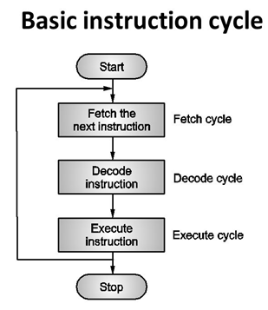
Instruction Cycle
The time required to fetch an instruction and necessary data from memory and to execute it, is called an instruction cycle. Or the total time required to execute an instruction is given by:
IC = FC + EC
Where,
IC = Instruction Cycle FC = Fetch Cycle EC = Execute Cycle

Slide 101
Fetch the instruction (Fetch Cycle)
In the beginning of the fetch cycle, the content of the program counter (PC), which is the address of the memory location where opcode is available, is sent to the memory. The memory puts the opcode on the data bus so as to transfer it to the CPU.
The whole operation of fetching an opcode takes three clock cycles. A slow memory may take more time.
Decode the instruction (Decode Cycle)
The opcode fetched from the memory goes to the data register, DR and then to instruction register, IR. From the IR it goes to the decoder circuitry which decodes the instruction. Decoder circuitry is within the microprocessor.
Execute the Instruction (Execute Cycle)
After the instruction is decoded, execution begins.
If the operand is reside the general purpose registers, execution is immediately performed. The time taken in decoding and execution of an instruction is one clock cycle.
In some situations, an execute cycle may involve one or more read or write cycles or both.

Slide 102
Read Cycle: If an instruction contains data or operand address which are in the memory, the CPU has to perform some read operations to get the desired data. In case of a read cycle the instruction received from the memory are data or operand address instead of an opcode.
Write Cycle: In write cycle data are sent from the CPU to the memory or an output device.
Machine Cycle and State
The necessary steps carried out to perform the operation of accessing either memory or input output device, constitute a machine cycle. In other words, necessary steps carried out to perform a fetch, a read or a write operation constitutes a machine cycle.
One sub-division of an operation performed in one clock cycle is called a state or T-state. In short, one clock cycle of the system clock is referred to as a state.

Slide 103
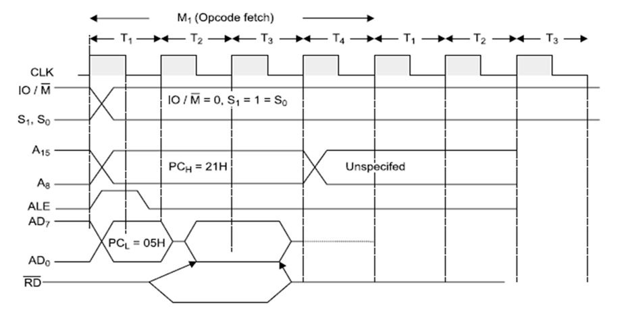
Timing Diagrams
The necessary steps carried out in a machine cycle can be represented graphically. Such a graphical representation is called timing diagram. The timing diagram for opcode fetch, memory read, memory write, I/O read and I/O write will be discussed below:
Timing Diagram for Opcode Fetch Cycle:

Slide 104
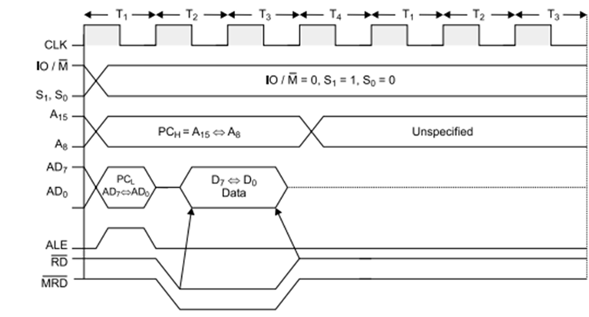
Timing Diagram for Memory Read

Slide 105
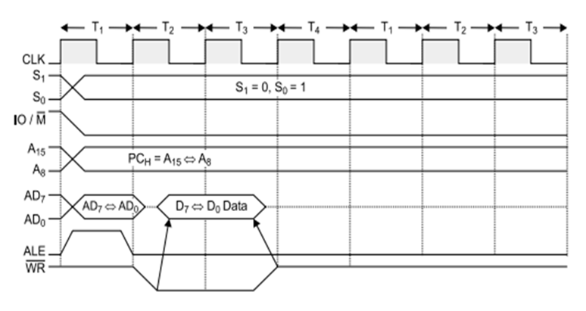
Timing Diagram for Memory Write

Slide 106
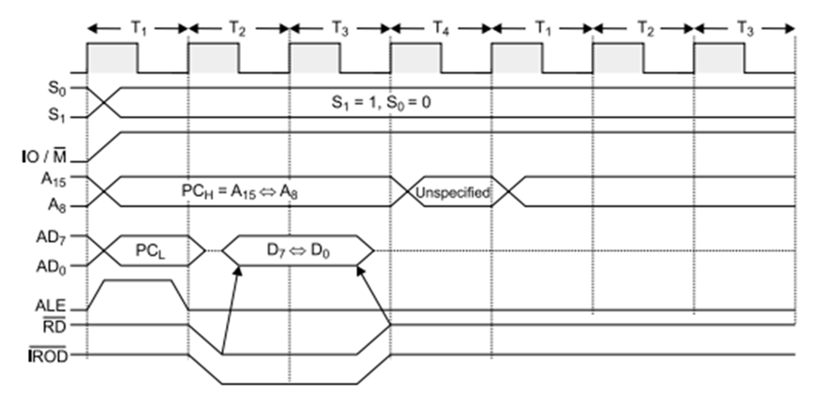
Timing Diagram for I/O Read

Slide 107
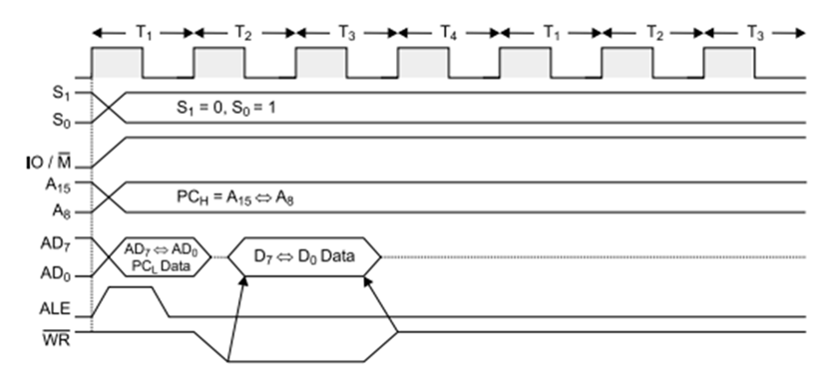
Timing Diagram for I/O Write

Slide 108
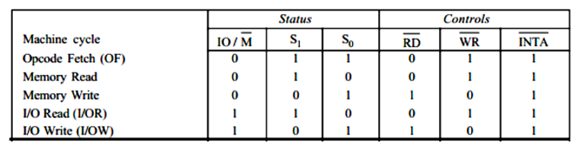
In the above diagrams, the basic used parameters are:
ALE: ALE indicates the availability of a valid address on the multiplexed address/data lines. When it is high or 1, then it acts as an address bus and when low or 0, then it acts as a data bus.
RD (low active): If it is high or 1, then no data is read by the microprocessor. If signal is low or 0, then data is read by the microprocessor.
WR (low active): If it is high or 1, then no data is written by the microprocessor. If signal is low or 0, then data is written by the microprocessor.
IO/M (low active): A high or 1 on this signal indicates I/O operation while a low or 0 indicates memory operation.
S₀, S₁: S0 and S1 Indicate the type of machine cycle in progress.
The below table, shows the status of different control signal for different operation:

Slide 109
Instruction Set of 8085
Instruction and Data Formats
The various techniques to specify data for instructions are:
8-bit or 16-bit data may be directly given in the instruction itself.
The address of the memory location, I/O port or I/O device, where data resides, may be given in the instruction itself.
In some instructions, only one register is specified. The content of the specified register is one of the operands.
Some instructions specify two registers. The contents of the registers are the required data.
In some instructions, data is implied. The most instructions of this type operate on the content of the accumulator.
Due to different ways of specifying data for instructions, the machine codes of all instructions are not of the same length. It may 1-byte, 2-byte or 3-byte instruction.

Slide 110
Addressing Modes
Each instruction requires some data on which it has to operate. There are different techniques to specify data for instructions. These techniques are called addressing modes. Intel 8085 uses the following addressing modes:
Direct Addressing
In this addressing mode, the address of the operand (data) is given in the instruction itself.
Example
STA 2400H: It stores the content of the accumulator in the memory location 2400H.
32, 00, 24: The above instruction in the code form.
In this instruction, 2400H is the memory address where data is to be stored. It is given in the instruction itself. The 2nd and 3rd bytes of the instruction specify the address of the memory location. Here, it is understood that the source of the data is accumulator.

Slide 111
Register Addressing
In register addressing mode, the operand is in one of the general purpose registers. The opcode specifies the address of the register(s) in addition to the operation to be performed.
Example:
MOV A, B: Move the content of B register to register A.
78: The instruction in the code form.
In the above example, MOV A, B is 78H. Besides the operation to be performed the opcode also specifies source and destination registers.
The opcode 78H can be written in binary form as 01111000. The first two bits, i.e. 0 1 are for MOV operation, the next three bits 1 1 1 are the binary code for register A, and the last three bits 000 are the binary code for register B.

Slide 112
Register Indirect Addressing
In Register Indirect mode of addressing, the address of the operand is specified by a register pair.
Example
LXI H, 2500 H - Load H-L pair with 2500H.
MOV A, M - Move the content of the memory location, whose address is in H-L pair (i.e. 2500 H) to the accumulator.
HLT - Halt.
In the above program the instruction MOV A, M is an example of register indirect addressing. For this instruction, the operand is in the memory. The address of the memory is not directly given in the instruction. The address of the memory resides in H-L pair and this has already been specified by an earlier instruction in the program, i.e. LXI H, 2500 H.

Slide 113
Immediate Addressing
In this addressing mode, the operand is specified within the instruction itself.
Example
LXI H, 2500 is an example of immediate addressing. 2500 is 16-bit data which is given in the instruction itself. It is to be loaded into H-L pair.

Slide 114
Implicit Addressing
There are certain instructions which operate on the content of the accumulator. Such instructions do not require the address of the operand.
Example
CMA, RAL, RAR, etc.

Slide 115
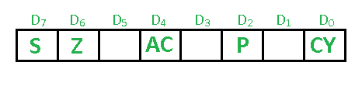
Status Flags
There is a set of five flip-flops which indicate status (condition) arising after the execution of arithmetic and logic instructions. These are:
Carry Flag (CS)
Parity Flag (P)
Auxiliary Carry Flags (AC)
Zero Flags (Z)
Sign Flags (S)

Slide 116
Symbols and Abbreviations
Symbol/Abbreviations | Meaning
Addr | 16-bit address of the memory location.
Data | 8-bit data
data 16 | 16-bit data
r, r1, r2 | One of the registers A, B, C, D, E, H or L
A, B, C, D, H, L | 8-bit register
A | Accumulator
H-L | Register pair H-L
B-C | Register pair B-C
D-E | Register pair D-E
PSW | Program Status Word
M | Memory whose address is in H-L pair
H | Appearing at the end of the group of digits specifies hexadecimal, e.g. 2500H
Rp | One of the register pairs.
Rh | The high order register of a register pair
Rl | The low order register of a register pair
PC | 16 bit program counter, PCH is high order 8 bits and PCL low order 8 bits of register PC.
CS | Carry Status
[] | The contents of the register identified within bracket
[ [] ] | The content of the memory location whose address is in the register pair identified within brackets
^ | AND operation
∨ | OR operation
⊕ or ∀ | Exclusive OR
← | Move data in the direction of arrow
⇔ | Exchange contents

Slide 117
Intel 8085 Instructions
An instruction of a computer is a command given to the computer to perform a specified operation on given data. In microprocessor, the instruction set is the collection of the instructions that the microprocessor is designed to execute.
The programmer writes a program in assembly language using these instructions. These instructions have been classified into the following groups:

Slide 118
Data Transfer Group
Instruction Set | Explanation | States | Flags | Addre-ssing | Machine Cycles | Example
MOV r₁, r₂ [r1] ← [r2] | Move the content of the one register to another | 4 | none | Register | 1 | MOV A, B
MOV r, M [r]←[[H-L]] | Move the content of memory to register | 7 | none | Register Indirect | 2 | MOV B, M
MOV M, r [[H-L]]←[r] | Move the content of register to memory | 7 | none | Register Indirect | 2 | MOV M, C
MVI r, data [r] ←data | Move immediate data to register | 7 | None | Immediate Register | 3 | MVI M, 08
LXI rp, data 16 [rp] ←data 16 bits, [rh] ←8 MSBs, [rl] ←8 LSBs of data | Load Register pair immediate | 10 | None | Immediate | 3 | LXI H, 2500H
LDA addr [A] ←[addr] | Load Accumulator direct | 13 | None | Direct | 4 | LDA 2400 H
STA Addr [addr] ←[A] | Store accumulator direct | 13 | None | Direct | 4 | STA 2000H
LHLD addr [L] ←[addr], [H] ← [addr + 1 ] | Load H-L pair direct | 16 | None | Direct | 5 | LHLD 2500H
SHLD addr [addr] ←[L], [addr +1] ← [H] | Store H-L pair direct | 16 | None | Direct | 5 | SHLD 2500 H
LDAX rp [A] ←[[rp]] | Load accumulator indirect | 7 | None | Register Indirect | 2 | LDAX B
STAX rp [[rp]] ←[A] | Store accumulator indirect | 7 | None | Register Indirect | 2 | STAX D
XCHG [H-L] ↔[D-E] | Change the contents of H-L with D-E pair | 4 | None | Register | 1

Slide 119
Arithmetic Group
Instruction Set | Explanation | States | Flags | Addre-ssing | Machine Cycles | Example
ADD r [A] ←[A]+[r] | Add register to accumulator | 4 | All | Register | 1 | ADD K
ADD M [A] ← [A] + [[H-L]] | Add memory to accumulator | 7 | All | Register indirect | 2 | ADD K
ACC r [A] ← [A] + [r] + [CS] | Add register with carry to accumulator | 4 | All | Register | 1 | ACC K
ADC M [A] ← [A] + [[H-L]] [CS] | Add memory with carry to accumulator | 7 | All | Register indirect | 2 | ADC K
ADI data [A] ← [A] + data | Add immediate data to accumulator | 7 | All | Immediate | 2 | ADI 55K
ACI data [A] ← [A] + data + [CS] | Add with carry immediate data to accumulator | 7 | All | Immediate | 2 | ACI 55K
DAD rp [H-L] ←[H-L] + [rp] | Add register paid to H-L pair | 10 | CS | Register | 3 | DAD K
SUB r [A] ←[A]-[r] | Subtract register from accumulator | 4 | All | Register | 1 | SUB K
SUB M [A] ← [A] - [[H-L]] | Subtract memory from accumulator | 7 | ALL | Register indirect | 2 | SUB K
SBB r [A] ←[A]-[H-L]] - [CS] | Subtract memory from accumulator with borrow | 7 | All | Register indirect | 2 | SBB K
SUI data [A] ←[A]-data | Subtract immediate data from accumulator | 7 | All | Immediate | 2 | SUI 55K
SBI data [A] ←[A]-data-[CS] | Subtract immediate data from accumulator with borrow | 7 | All | Immediate | 2 | XCHG
INR r [r] ←[r]+1 | Increment register content | 4 | All except carry flag | Register | 1 | INR K
INR M [[H-L]] ←[[H-L]]+1 | Increment memory content | 10 | All except carry flag | Register indirect | 3 | INR K
DCR r [r] ←[r] -1 | Decrement register content | 4 | All except carry flag | Register | 1 | DCR K
DCR M [[H-L]] ← [[H-L]]-1 | Decrement memory content | 10 | All except carry flag | Register indirect | 3 | DCR K
INX rp [rp] ←[rp]+1 | Increment memory content | 6 | None | Register | 1 | INX K
DCX rp [rp] ←[rp]-1 | Decrement register pair | 6 | None | Register | 1 | DCX K
DAA | Decimal adjust accumulator | 4 |  |  | 1 | DAA

Slide 120
Logical Group
Instruction Set | Explanation | States | Flags | Addressing | Machine Cycles
ANA r [A] ←[A]∧[r] | AND register with accumulator | 4 | All | Register | 1
ANA M [A] ←[A]∧[[H-]] | AND memory with accumulator | 4 | All | Register indirect | 2
ANI data [A] ← [A] ∧ [data] | AND immediate data with accumulator | 7 | All | Immediate | 2
ORA r [A] ←[A]∨[r] | OR-register with accumulator | 4 | All | Register | 1
ORA M [A] ←[A]∨[[H-L]] | OR-memory with accumulator | 7 | All | Register indirect | 2
ORI data [A] ← [A] ∨ [data] | OR -immediate data with accumulator | 7 | All | Immediate | 2
XRA r [A] ← [A]∀[r] | XOR register with accumulator | 4 | All | Register | 1
XRA M [A] ← [A] ∀ [[H-L]] | XOR memory with accumulator | 7 | All | Register indirect | 2
XRI data [A] ←[A] ∀ [data] | XOR immediate data with accumulator | 7 | All | Immediate | 2
CMA [A] ←[A] | Complement the accumulator | 4 | None | Implicit | 1
CMC [CS] ←[CS] | Complement the carry status | 4 | CS |  | 1
STC [CS] ← 1 | Set carry status | 4 | CS |  | 1
CMP r [A]-[r] | Compare register with accumulator | 4 | All | Register | 1
CMP M [A] - [[H-L]] | Compare memory with accumulator | 7 | All | Register indirect | 2
CPI data [A] - data | Compare immediate data with accumulator | 7 | All | Immediate | 2
RLC [A_{n+1}] ←[A^{n}], [A⁰] ←[A⁷], [CS] ←[A⁷] | Rotate accumulator left | 4 | Cs | Implicit | 1
RRC [A⁷] ←[A⁰], [CS] ←[A⁰], [A^{n}] ←[A^{n+1}] | Rotate accumulator right |  | CS | Implicit | 1
RAL [A^{n+1}] ←[A^{n}], [CS] ←[A⁷], [A⁰] ←[CS] | Rotate accumulator left through carry |  | CS | Implicit | 1
RAR [A^{n}] ←[A^{n+1}], [CS] ←[A⁰], [A⁷] ←[CS] | Rotate accumulator right through carry |  | CS | Implicit | 1

Slide 121
Branch Control Group
This group contains the instructions for conditional and unconditional jump, subroutine call and return, and restart.
Unconditional Jump
Instruction Set | Explanation | States | Flags | Addressing | Machine Cycles
JMP addr(label) [PC] ← Label | Unconditional jump: jump to the instruction specified by the address | 10 | None | Immediate | 3
Conditional Jump
Instruction Set | Explanation | States | Machine Cycles
Jump addr (label) [PC] ← Label | Conditional jump: jump to the instruction specified by the address if the specified condition is fulfilled | 10, if true and 7, if not true | 3, if true and 2, if not true

Slide 122
Programming in 8085
Let's see some simple example to demonstrate the use of some important instructions of 8085.
The memory addresses given in the program are for a particular microprocessor kit. These addresses can be changed to suit the microprocessor kit available in your system.
Store 8-bit data in memory

Slide 123
Program
Store 8-bit data in memory using direct addressing
MVI A, 49H : "Store 49H in the accumulator"
STA 2501H : "Copy accumulator contents at address 2501H"
HLT : "Stop"
Store 8-bit data in memory using indirect addressing
LXI H : "Load H-L pair with 2501H"
MVI M : "Store 49H in memory location pointed by H-L register pair (2501H)"
HLT : "Stop"

Slide 124
Add two 8-bit numbers
Example
(2501 H) = 99H
(2502 H) = 39H
Result (2503 H) = 99H + 39H = D2H
Since, 1 0 0 1 1 0 0 1 (99H)
+ 0 0 1 1 1 0 0 1 (39H)
1 1 0 1 0 0 1 0 (D2H)
Program
LXI H, 2501H : "Get address of first number in H-L pair. Now H-L points to 2501H"
MOV A, M : "Get first operand in accumulator"
INX H : "Increment content of H-L pair. Now, H-L points 2502H"
ADD M : "Add first and second operand"
INX H : "H-L points 4002H"
MOV M, A : "Store result at 25 03H"
HLT : "Stop"

Slide 125
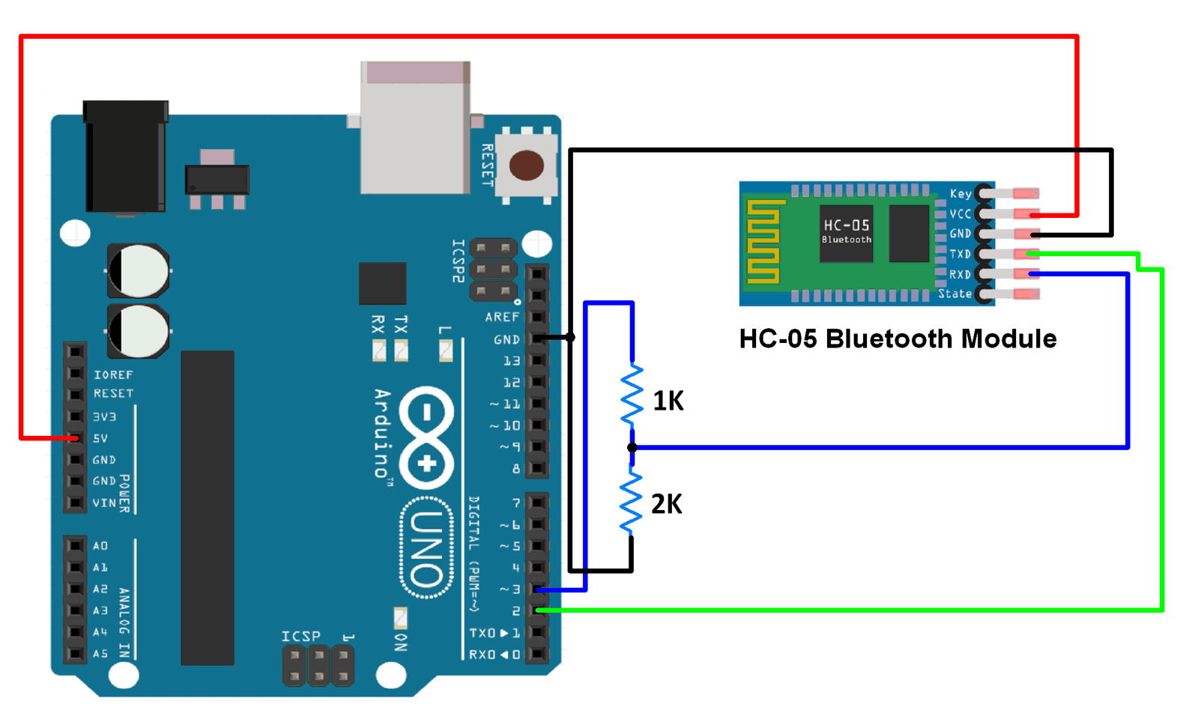

Slide 126
Subtract two 8-bit numbers
Example
(2501 H) = 49H
(2502 H) = 32H
Result (2503 H) = 49H
-32H
= 17H
Program
LXI H, 2501H : "Get address of first number in H-L pair. Now H-L points to 2501H"
MOV A, M : "Get first operand in accumulator"
INX H : "Increment content of H-L pair. Now, H-L points 2502H"
SUB M : "Subtract first to second operand"
INX H : "H-L points 4002H"
MOV M, A : "Store result at 2503H"
HLT : "Stop"

Slide 127
Add two 16-bits numbers
Add the 16-bit number in memory locations 2501H and 2502H to the 16-bit number in memory locations 2503H and 2504H. The most significant eight bits of the two numbers to be added are in memory locations 2502H and 4004H. Store the result in memory locations 2505H and 2506H with the most significant byte in memory location 2506H.
Example
(2501H) = 15H
(2502H) = 1CH
(2503H) = B7H
(2504H) = 5AH
Result = 1C15 + 5AB7H = 76CCH
(2505H) = CCH
(2506H) = 76H

Slide 128
Program Add two 16-bits number with ADD and ADC instruction
LHLD 2501H : "Get 1st 16-bit number in H-L pair"
XCHG : "Save 1st 16-bit number in DE"
LHLD 2503H : "Get 2nd 16-bit number in H-L pair"
MOV A, E : "Get lower byte of the 1st number"
ADD L : "Add lower byte of the 2nd number"
MOV L, A : "Store result in L-register"
MOV A, D : "Get higher byte of the 1st number"
ADC H : "Add higher byte of the 2nd number with CARRY"
MOV H, A : "Store result in H-register"
SHLD 4004H : "Store 16-bit result in memory locations 2505H and 2506H"
HLT : "Stop"

Slide 129
Embedded System Project: Fire Detection
Fire Sense using 8051 Microcontroller and Flame Sensor
To avoid all the problems mentioned about the current fire fighting system and to have a better and reliable security system against fire accidents. There is used fire sensor which senses fire. If fire start, motor turn ON. If there is not firing, motor is turn OFF.
REQUIREMENTS:
MICROCONTROLLER 89C2051 (8051)
CRYSTAL OSCILLATOR
RESISTORS
DIODES
TRANSFORMER
CAPACITORS
CONNECTORS
DC MOTOR
RELAY
BUZZER
FLAME SENSOR

Slide 130
Aim of the Project
Aim of the Project
Our aim is to design such project that sense fire. When there will be firing, motor will turn ON and water is start otherwise motor will be turn OFF.
In places where such systems were installed it was seldom observed that they posed more problems than solutions. For example, many times the sprinklers went off because of the smoke caused by some harmless reason thereby creating a lot of mess and nuisance even when there was no fire. Thus a problem of false alarm was there. Not only this, in places like offices, museums, etc. sometimes when a small fire broke out, the damage caused by the water sprinklers, by spoiling the important paperwork, electronic items or pieces of art and history, was more than what the fire could have caused.

Slide 131
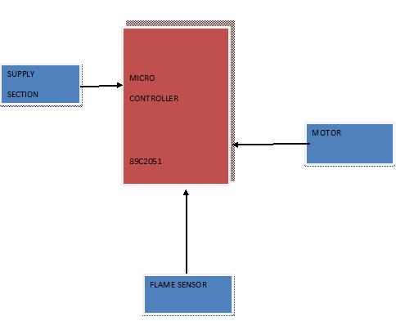
Block Diagram
Consider the block diagram of fire sensing circuit using microcontroller and flame sensor as key component is:-

Slide 132
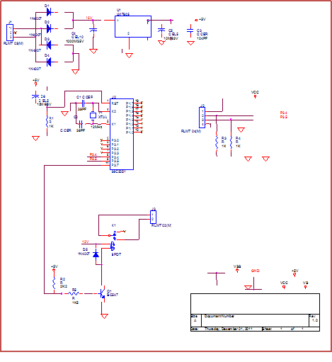
Working of the Project
This project comprises microcontroller one is for decision making. Fire sensor is for sensing fire. There is used fire sensor which senses fire. If fire start, motor turn ON. If there is not firing, motor is turn OFF. In this project we use 89c2051.

Slide 133
Circuit Description
POWER SUPPLY SECTION:
RLMT Connector- It is a connector used to connect the step down transformer to the bridge rectifier.
Capacitor- It is an electrolytic capacitor of rating 1000M/35V used to remove the ripples. Capacitor is the component used to pass the ac and block the dc.
Regulator- LM7805 is used to give a fixed 5v regulated supply.
Capacitor- It is again an electrolytic capacitor 10M/65v used for filtering to give pure dc.
Capacitor- It is a ceramic capacitor used to remove the spikes generated when frequency is high (spikes). So the output of supply section is 5v regulated dc.

Slide 134
Microcontroller Section
+5v supply-This +5v supply is required for the controller to get start which is provided from the power supply section. This supply is provided at pin no. 20 of the 89c2051 controller.
Crystal Oscillator- A crystal oscillator of 12 MHz is connected at pin no.5, x1 and pin no.4, x2 to generate the frequency for the controller. The crystal oscillator works on piezoelectric effect. The clock generated is used to determine the processing speed of the controller. Two capacitors are also connected one end with the oscillator while the other end is connected with the ground.
Reset section- It consists of an RC network consisting of capacitor and one resistance of 1k. This section is used to reset the controller connected at pin no.1 of AT89c2051.

Slide 135
Source Code:
INCLUDE 89c51.mc
main:
JNB p3.4,la1 // At Port 3.4 Flame Sensor is Connected
SETB p3.7 // At port 3.7 Water Sprinkler Motor is Connected
Jmp main
la1:
CLR p3.7
JMP main

Slide 136
Embedded System Project: RFID Based Attendance System
RFID Based Attendance System Using 8051 Microcontroller
Nowadays, attendance in schools and colleges is based on paper. Sometimes this process causes errors and takes more time.
This project uses RFID technology for making a note of every student entering in a classroom and also calculates the time resides in a class.
In this system every student is allotted with an RFID tag. The attendance can be done by placing card near RFID reader.

Slide 137
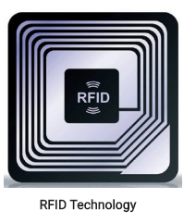
What is RFID?
The Radio Frequency Identification (RFID) is an electronic device which includes a small antenna and a chip. This device is used for transmitting information between reader and RFID tag using radio frequency electromagnetic fields.
The operating frequency ranges of these devices include low, mid and high ranges. The low frequency range is from 30 KHz to 500 KHz, middle frequency range is from 500 KHz to 900 KHz and high frequency range is from 2.4 MHz to 2.5 MHz

Slide 138
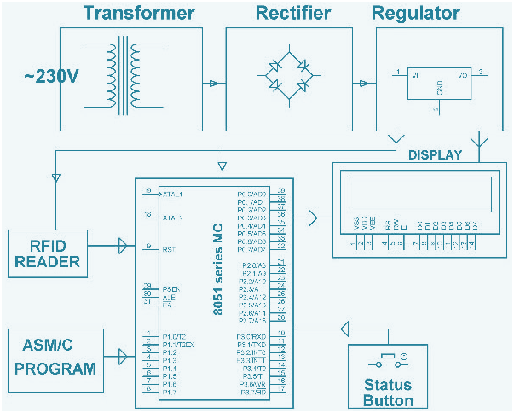
Block Diagram of RFID Based Attendance system
The attendance system in most of schools and colleges is mostly documented based. For automatic attendance system a wireless technology based RFID system is proposed. Every student is provided with an RFID tag, which uses inbuilt IC for storing and processing the information.
The block diagram of this system includes preset circuit, a microcontroller, an oscillator circuit, LCD display and an RFID reader.

Slide 139
Microcontroller-The microcontroller used in a RFID based attendance system is AT89C52 from the family of 8051. It includes 4-I/O ports and 40-pins.
Oscillator Circuit-Oscillator circuit is connected in between the pins of 18 and 19 of a microcontroller. This circuit is built with a combination of oscillator and two 33 pF capacitors at 11.0592 MHz operational frequency.
Preset Circuit-The microcontroller AT89C52 9th pin is reset pin. The circuit of the preset is built with a capacitor, a resistor and a switch. When switch is pressed, the reset pin is connected with and the microcontroller becomes reset.
LCD Display-LCD display is consists of 16 pins, where 3 pins are connected with and remaining all pins are connected with the port-2 of the microcontroller.
RFID Reader-RFID reader is used for reading the information which is stored in the RFID tags. It incorporates with any type of hardware design.

Slide 140
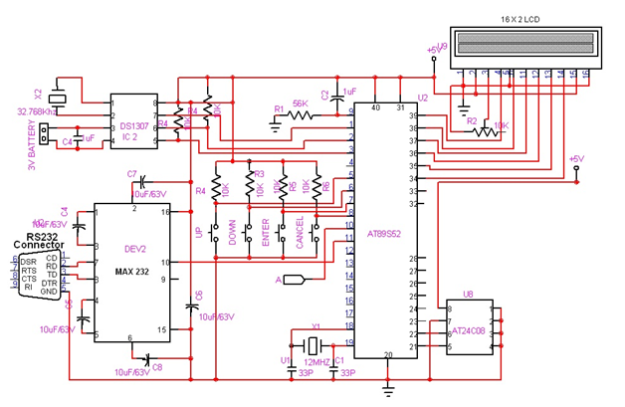
Working of Attendance System Circuit
After connecting all the components of attendance system, give the power supply to switch on the circuit. Then LCD will displays, please swipe the card. The information contain in the RFID tag is stated as the ID and attendance of the student. When person placed card in front of RFID reader, it reads the information and start matching with the information stored in the AT89S52 microcontroller. Before operation microcontroller is preprogrammed with embedded C language.

Slide 141
Source Code:
#include<reg51.h>
#include<string.h>
//0000 to 7FFF
sbit RS = P0^7;
sbit EN = P0^6;
sbit SDA = P1^0;
sbit SCL = P1^1;
sbit RELAY = P1^2;
code unsigned char RFID_1[] = "34006C9C04C0"; //34006C9C04+NULL
code unsigned char RFID_2[] = "34006C549C90";
code unsigned char RFID_3[] = "1300F8FAC1D0";
code unsigned char RFID_4[] = "34006CD5AD20";
code unsigned char RFID_5[] = "420061231E1E";
code unsigned char name_1[] = "SANJAY JAIN";
code unsigned char name_2[] = "SHEKHAT HARSH";
code unsigned char name_3[] = "DHOLARIYA RAKSHIT";
code unsigned char name_4[] = "DIVYANG SINGH ";
code unsigned char name_5[] = "NAKUL JAIN";

Slide 142
unsigned char rs[15];
unsigned int no_of_records;
void delay()
{
int j;
for(j=0;j<500;j++);
}
void long_delay()
{
unsigned int j;
for(j=0;j<65000;j++);
}
void idelay()
{
unsigned int j;
for(j=0;j<10000;j++);
}

Slide 143
void lcd_command(char lc)
{
P2 = lc;
RS = 0;
EN = 1;
delay();
EN = 0;
}
void lcd_data(char ld)
{
P2 = ld;
RS = 1;
EN = 1;
delay();
EN = 0;
}
void lcd_init()
{
lcd_command(0x38);
lcd_command(0x0E);
lcd_command(0x01);
}

Slide 144
void serial_init()
{
TMOD = 0x20;
SCON = 0x50;
TH1 = 0xFD;
TR1 = 1;
}
void transmit(unsigned char tx)
{
SBUF = tx;
while(TI==0);
TI = 0;
}
void send_string(unsigned char *str)
{
int j;
for(j=0;str[j]!='\0';j++)
transmit(str[j]);
}

Slide 145
unsigned char receive()
{
char rx;
while(RI==0);
RI = 0;
rx = SBUF;
return(rx);
}
void lcd_string(char add,char *str)
{
int j;
lcd_command(add);
for(j=0;str[j]!='\0';j++)
lcd_data(str[j]);
}
void start()
{
SDA = 1;
SCL = 1;
SDA = 0;
}
void stop()
{
SDA = 0;
SCL = 1;
SDA = 1;
}

Slide 146
void write(unsigned char w)
{
int j;
SCL = 0;
for(j=0;j<8;j++)
{
if((w & 0x80)==0)
SDA = 0;
else
SDA = 1;
SCL = 1;
SCL = 0;
ww = w << 1;
}
SCL = 1;
SCL = 0;
}
unsigned char read()
{
int j;
unsigned char r = 0x00;
SDA = 1;
for(j=0;j<8;j++)
{
SCL = 1;
rr = r << 1;
if(SDA == 1)
rr = r | 0x01;
SCL = 0;
}
return(r);
}
void ack()
{
SDA = 0;
SCL = 1;
SCL = 0;
}

Slide 147
void nack()
{
SDA = 1;
SCL = 1;
SCL = 0;
}
void rtc_read()
{
unsigned char ss,mm,hh,day,mn,date,yr;
start();
write(0xD0);
write(0x00);
stop();
start();
write(0xD1);
ss = read();
ack();
mm = read();
ack();
hh = read();
ack();
day = read();
ack();
date = read();
ack();
mn = read();
ack();
yr = read();
nack();
stop();
rs[0] = hh/0x10 + 48;
rs[1] = hh%0x10 + 48;
rs[2] = ':';
rs[3] = mm/0x10 + 48;
rs[4] = mm%0x10 + 48;
rs[5] = ',';
rs[6] = date/0x10 + 48;
rs[7] = date%0x10 + 48;
rs[8] = '/';
rs[9] = mn/0x10 + 48;
rs[10] = mn%0x10 + 48;
rs[11] = '/';
rs[12] = yr/0x10 + 48;
rs[13] = yr%0x10 + 48;
rs[14] = '\0';
}

Slide 148
void rtc_init()
{
start();
write(0xD0);
write(0x00);
write(0x00);
write(0x00);
write(0x13);
write(0x05);
write(0x12);
write(0x04);
write(0x12);
stop();
}
void write_records(unsigned char *str);
void read_records();
void main()
{
unsigned char rec_data[13],i,t;
RELAY = 0;
lcd_init();
serial_init();
rtc_init();
idelay();
start();
write(0xA0);
write(0x7F);
write(0xFF);
stop();
start();
write(0xA1);
no_of_records = read();
nack();
stop();

Slide 149
// no_of_records = 0;
while(1)
{
start:
lcd_command(0x01);
lcd_string(0x80,"RFID ATTENDANCE");
lcd_string(0xC5,"SYSTEM");
j = 0;
while(1)
{
if(RI==1)
{
RI = 0;
t = receive();
if(t == '+')
{
read_records();
goto start;
}
else
{
rec_data[j] = t;
for(j=1;j<12;j++)
rec_data[j] = receive();
rec_data[j] = '\0';
break;
}
}
}
j = strcmp(RFID_1,rec_data); //match => j = 0
lcd_command(0x01);
if(j==0)
{
RELAY = 1;
lcd_string(0x80,name_1);
rtc_read();
lcd_string(0xC0,rs);
long_delay();
write_records(name_1);
RELAY = 0;
goto start;
}

Slide 150
j = strcmp(RFID_2,rec_data); //match => j = 0
if(j==0)
{
RELAY = 1;
lcd_string(0x80,name_2);
rtc_read();
lcd_string(0xC0,rs);
long_delay();
write_records(name_2);
RELAY = 0;
goto start;
}
//
j = strcmp(RFID_3,rec_data); //match => j = 0
if(j==0)
{
RELAY = 1;
lcd_string(0x80,name_3);
rtc_read();
lcd_string(0xC0,rs);
long_delay();
write_records(name_3);
RELAY = 0;
goto start;
}
j = strcmp(RFID_4,rec_data); //match => j = 0
if(j==0)

Slide 151
{
RELAY = 1;
lcd_string(0x80,name_4);
rtc_read();
lcd_string(0xC0,rs);
long_delay();
write_records(name_4);
RELAY = 0;
goto start;
}
j = strcmp(RFID_5,rec_data); //match => j = 0
if(j==0)
{
RELAY = 1;
lcd_string(0x80,name_5);
no_of_records = 0;
start();
write(0xA0);
write(0x7F);
write(0xFF);
write(0x00);
stop();
lcd_string(0xC0,"MEMORY CLEARED");
long_delay();
RELAY = 0;
goto start;
}
lcd_string(0x80,"ERROR");
lcd_string(0xC0,rec_data);
long_delay();
}
}

Slide 152


C VS EMBEDDED C
C programming language is a widely used high-level programming language that is popular in the development of operating systems, application software, and system software.
Embedded C is a variant of C that is specifically designed for programming embedded systems, such as microcontrollers, microprocessors, and other programmable devices. In this article, we will discuss the differences between C and Embedded C.

Slide 153
"C" is a programming language that was developed in the 1970s by Dennis Ritchie at Bell Labs. It is a general-purpose, procedural programming language known for its efficiency, portability, and low-level system programming capabilities. Here are some advantages and disadvantages of using C:
Advantages of C:
Efficiency:
C is known for its efficiency in terms of both execution speed and memory usage. It allows for direct manipulation of computer hardware, which makes it suitable for performance-critical applications such as embedded systems, operating systems, and game development.
Portability:
C code can be compiled and executed on different platforms, including various operating systems and hardware architectures, with minimal or no modifications. It makes C a portable language, allowing developers to write code once and run it on multiple platforms, which is a significant advantage for cross-platform development.
Flexibility:
C provides low-level features like pointers and memory manipulation, which give programmers fine-grained control over the hardware resources of a system. It allows for optimized code and efficient memory management, making it a popular choice for systems programming and embedded systems development.
Large Community and Libraries:
C has a large community of developers and a vast ecosystem of libraries and tools. There are abundant resources available for learning, support, and code reuse, making it easier for developers to find solutions to problems and leverage existing code to accelerate development.

Slide 154
Disadvantages of C:
Complexity:
C has a steeper learning curve compared to some other modern programming languages due to its low-level features, such as pointers and manual memory management. Writing C code requires careful consideration of memory allocation, pointer manipulation, and other low-level details, which can be error-prone and lead to bugs, crashes, and security vulnerabilities.
Lack of built-in features:
C is a relatively low-level language, and it lacks many of the high-level features that are common in modern programming languages, such as garbage collection, built-in support for object-oriented programming, and dynamic memory allocation. It means that developers need to implement these features manually, which can be time-consuming and error-prone.
Vulnerability to security risks:
C allows direct manipulation of memory through pointers, which can lead to memory-related vulnerabilities such as buffer overflows, null pointer dereferences, and other security risks if not handled carefully. Writing secure C code requires meticulous attention to memory management and input validation, which can be challenging for inexperienced developers.
Compile-time dependencies:
C code is compiled into machine code specific to a target platform, which means that changes in hardware architecture or operating system may require recompilation and potentially modification of the code. It can add complexity and maintenance overhead, especially in large projects or when targeting multiple platforms.

Slide 155
Flow of C Program
The C program follows many steps in execution. To understand the flow of C program well, let us see a simple program first.
File: simple.c
#include <stdio.h>
int main(){
printf("Hello C Language");
return 0;
}

Slide 156
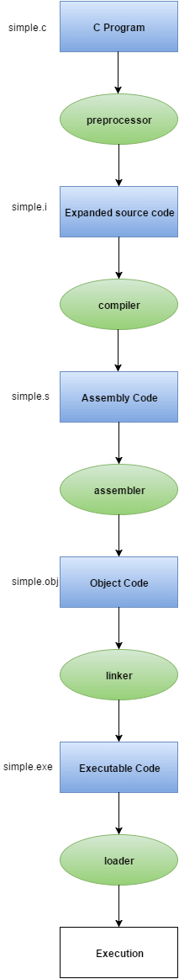

Slide 157
Let's try to understand the flow of above program by the figure given below.
1) C program (source code) is sent to preprocessor first. The preprocessor is responsible to convert preprocessor directives into their respective values. The preprocessor generates an expanded source code.
2) Expanded source code is sent to compiler which compiles the code and converts it into assembly code.
3) The assembly code is sent to assembler which assembles the code and converts it into object code. Now a simple.obj file is generated.
4) The object code is sent to linker which links it to the library such as header files. Then it is converted into executable code. A simple.exe file is generated.
5) The executable code is sent to loader which loads it into memory and then it is executed. After execution, output is sent to console.

Slide 158
What is Embedded C?
Embedded C is a variant of the C programming language that is specifically tailored for developing software for embedded systems, which are specialized computing systems embedded in various devices, such as microcontrollers, sensors, appliances, automotive systems, and industrial control systems. Here are some advantages and disadvantages of using Embedded C:
Advantages of Embedded C:
Efficiency:
Embedded C allows for efficient programming and optimization of system resources, such as memory, processing power, and energy consumption. It is critical in embedded systems, where resources are often limited and need to be carefully managed for optimal performance.
Portability:
Embedded C code can be compiled and executed on different embedded platforms with minimal or no modifications, making it portable across various embedded systems. It enables code to reuse and simplifies the process of developing software for different hardware platforms.
Low-level hardware access:
Embedded C provides low-level features, such as direct register access and bit manipulation, which allow for precise control over the hardware resources of an embedded system. This level of control is essential in embedded systems, where hardware interactions are often critical for functionality and performance.
Real-time capabilities:
Embedded C allows for precise timing control, making it suitable for real-time applications where timing constraints are crucial, such as in control systems, communication protocols, and signal processing applications.

Slide 159
Disadvantages of Embedded C:
Steeper learning curve:
Embedded C requires a good understanding of low-level hardware concepts, such as memory management, register access, and interrupts, which can be more complex compared to standard C programming. It may require additional effort to learn and master, especially for developers who are not familiar with embedded systems or low-level programming.
Lack of standardization:
Embedded systems are highly diverse, with various hardware architectures, operating systems, and development tools available. Embedded C lacks a standardized library or framework, which means that developers often need to rely on vendor-specific libraries or write custom code for hardware abstraction and peripheral access, leading to potential fragmentation and portability challenges.
Limited high-level features:
Embedded C may lack some of the high-level features commonly found in modern programming languages, such as garbage collection, dynamic memory allocation, and object-oriented programming, which can make development more complex and time-consuming.
Security risks:
Embedded C allows for direct manipulation of memory through pointers, which can lead to memory-related vulnerabilities if not handled carefully. Writing secure Embedded C code requires diligent attention to memory management and input validation to avoid security risks, especially in safety-critical embedded systems.

Slide 161
Basic Declaration

Slide 162
Basic Embedded C Programming Steps

Slide 163
Feature | C | Embedded C
Programming Style | It is a general-purpose programming. | It is an embedded systems programming.
Memory Usage | Assumes plentiful memory resources | Optimized for limited memory resources
Input/Output Operations | Standard input/output libraries | Hardware-specific input/output libraries
Interrupt Handling | No built-in features | Built-in features for predictable and efficient interrupt handling
Data Types | Optimized for general-purpose computing | Additional data types optimized for embedded systems
Control Structures | Similar to those in C | Optimized for embedded systems
Compiler Optimization | Optimized for general-purpose computing | Optimized for resource usage and hardware platform
Libraries | General-purpose libraries | Hardware-specific libraries optimized for memory usage

Slide 164
Signed and Unsigned Binary Numbers
The integer variables are represented in a signed and unsigned manner. The positive and negative values are differentiated by using the sign flag in signed numbers. The unsigned numbers do not use any flag for the sign, i.e., only positive numbers can be stored by the unsigned numbers.
It is very easy to represent positive and negative numbers in our day to day life. We represent the positive numbers without adding any sign before them and the negative number with - (minus) sign before them. But in the digital system, it is not possible to use negative sign before them because the data is in binary form in digital computers. For representing the sign in binary numbers, we require a special notation.

Slide 165
Binary Numbers Representation
Our computer can understand only (0, 1) language. The binary numbers are represented in both ways, i.e., signed and unsigned. The positive numbers are represented in both ways- signed and unsigned, but the negative numbers can only be described in a signed way. The difference between unsigned and signed numbers is that unsigned numbers do not use any sign bit for positive and negative numbers identification, but the signed number used.

Slide 166
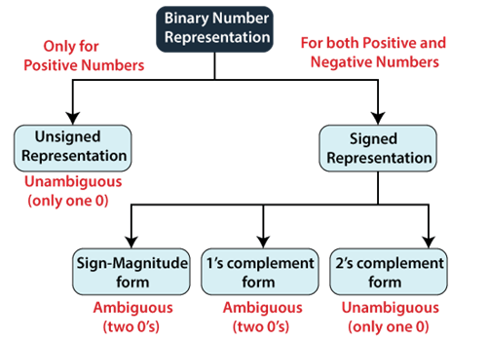

Slide 167
Unsigned Numbers
As we already know, the unsigned numbers don't have any sign for representing negative numbers. So the unsigned numbers are always positive. By default, the decimal number representation is positive. We always assume a positive sign in front of each decimal digit.
There is no sign bit in unsigned binary numbers so it can only represent its magnitude. In zero and one, zero is an unsigned binary number. There is only one zero (0) in this representation, which is always positive. Because of one unique binary equivalent form of a number in unsigned number representation, it is known as unambiguous representation technique. The range of the unsigned binary numbers starts from 0 to (2^{n}-1).

Slide 168
Example: Represent the decimal number 102 in unsigned binary numbers.
We will change this decimal number into binary, which has the only magnitude of the given name.
Decimal | Operation | Result | Remainder
102 | 102/2 | 51 | 0
51 | 51/2 | 25 | 1
25 | 25/2 | 12 | 1
12 | 12/2 | 6 | 0
6 | 6/2 | 3 | 0
3 | 3/2 | 1 | 1
1 | 1/2 | 0 | 1
So the binary number of (102)₁₀ is (1100110)₂, a 7-bit magnitude of the decimal number 102.

Slide 169
Signed Numbers
The signed numbers have a sign bit so that it can differentiate positive and negative integer numbers. The signed binary number technique has both the sign bit and the magnitude of the number. For representing the negative decimal number, the corresponding symbol in front of the binary number will be added.

Slide 170
The signed numbers are represented in three ways. The signed bit makes two possible representations of zero (positive (0) and negative (1)), which is an ambiguous representation. The third representation is 2's complement representation in which no double representation of zero is possible, which makes it unambiguous representation. There are the following types of representation of signed binary numbers:
Sign-Magnitudeform In this form, a binary number has a bit for a sign symbol. If this bit is set to 1, the number will be negative else the number will be positive if it is set to 0. Apart from this sign-bit, the n-1 bits represent the magnitude of the number.
1'sComplement By inverting each bit of a number, we can obtain the 1's complement of a number. The negative numbers can be represented in the form of 1's complement. In this form, the binary number also has an extra bit for sign representation as a sign-magnitude form.
2'sComplement By inverting each bit of a number and adding plus 1 to its least significant bit, we can obtain the 2's complement of a number. The negative numbers can also be represented in the form of 2's complement. In this form, the binary number also has an extra bit for sign representation as a sign-magnitude form.

Slide 171
Example 1: 11010.1101
For finding 1's complement of the given number, change all 0's to 1 and all 1's to 0. So the 1's complement of the number 11010.1101 comes out 00101.0010.
Example 2: 100110.1001
For finding 1's complement of the given number, change all 0's to 1 and all 1's to 0. So, the 1's complement of the number 100110.1001 comes out 011001.0110.
Binary Number | 1's Complement
0000 | 1111
0001 | 1110
0010 | 1101
0011 | 1100
0100 | 1011
0101 | 1010

Slide 172
Use of 1's complement
1's complement plays an important role in representing the signed binary numbers. The main use of 1's complement is to represent a signed binary number. Apart from this, it is also used to perform various arithmetic operations such as addition and subtraction.
In signed binary number representation, we can represent both positive and negative numbers. For representing the positive numbers, there is nothing to do. But for representing negative numbers, we have to use 1's complement technique. For representing the negative number, we first have to represent it with a positive sign, and then we find the 1's complement of it.
Let's take an example of a positive and negative number and see how these numbers are represented.
Example 1: +6 and -6
The number +6 is represented as same as the binary number. For representing both numbers, we will take the 5-bit register.
So the +6 is represented in the 5-bit register as 0 0110.
The -6 is represented in the 5-bit register in the following way:
+6=0 0110
Find the 1's complement of the number 0 0110, i.e., 1 1001. Here, MSB denotes that a number is a negative number.

Slide 173
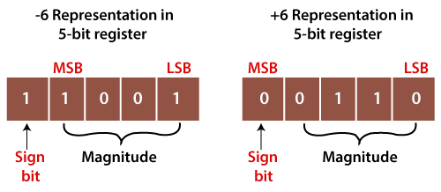

Slide 174
2s
Example 1: 110100
For finding 2's complement of the given number, change all 0's to 1 and all 1's to 0. So the 1's complement of the number 110100 is 001011. Now add 1 to the LSB of this number, i.e., (001011)+1=001100.
Example 2: 100110
For finding 1's complement of the given number, change all 0's to 1 and all 1's to 0. So, the 1's complement of the number 100110 is 011001. Now add one the LSB of this number, i.e., (011001)+1=011010.

Slide 175
2's Complement Table
Binary Number | 1's Complement | 2's complement
0000 | 1111 | 0000
0001 | 1110 | 1111
0010 | 1101 | 1110
0011 | 1100 | 1101
0100 | 1011 | 1100
0101 | 1010 | 1011
0110 | 1001 | 1010
0111 | 1000 | 1001

Slide 176
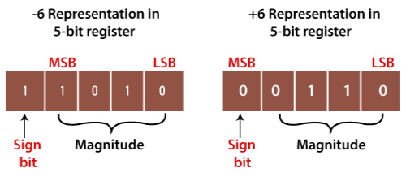
2s use
Example 1: +6 and -6
The number +6 is represented as same as the binary number. For representing both numbers, take the 5-bit register.
So the +6 is represented in the 5-bit register as 0 0110.
The -6 is represented in the 5-bit register in the following way:
+6=0 0110
Now, find the 1's complement of the number 0 0110, i.e. 1 1001.
Now, add 1 to its LSB. When we add 1 to the LSB of 11001, the newly generated number comes out 11010. Here, the sign bit is one which means the number is the negative number.

Slide 177
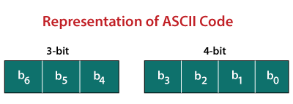
ASCII Code
The ASCII stands for American Standard Code for Information Interchange. The ASCII code is an alphanumeric code used for data communication in digital computers. The ASCII is a 7-bit code capable of representing 2⁷ or 128 number of different characters. The ASCII code is made up of a three-bit group, which is followed by a four-bit code.

Slide 178
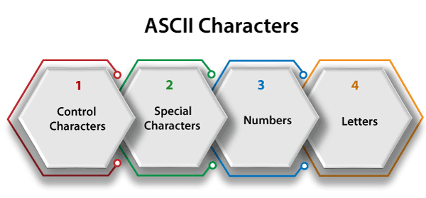
The ASCII Code is a 7 or 8-bit alphanumeric code.
This code can represent 127 unique characters.
The ASCII code starts from 00h to 7Fh. In this, the code from 00h to 1Fh is used for control characters, and the code from 20h to 7Fh is used for graphic symbols.
The 8-bit code holds ASCII, which supports 256 symbols where math and graphic symbols are added.
The range of the extended ASCII is 80h to FFh.

Slide 179
Control Characters
The non-printable characters used for sending commands to the PC or printer are known as control characters. We can set tabs, and line breaks functionality by this code. The control characters are based on telex technology. Nowadays, it's not so much popular in use. The character from 0 to 31 and 127 comes under control characters.
Special Characters
All printable characters that are neither numbers nor letters come under the special characters. These characters contain technical, punctuation, and mathematical characters with space also. The character from 32 to 47, 58 to 64, 91 to 96, and 123 to 126 comes under this category.
Numbers Characters
This category of ASCII code contains ten Arabic numerals from 0 to 9.
Letters Characters
In this category, two groups of letters are contained, i.e., the group of uppercase letters and the group of lowercase letters. The range from 65 to 90 and 97 to 122 comes under this category.

Slide 180
Example 1: (10010101100001111011011000011010100111000011011111101001 110111011101001000000011000101100100110011)₂
Step 1: In the first step, we we make the groups of 7-bits because the ASCII code is 7 bit.
1001010 1100001 1110110 1100001 1010100 1110000 1101111 1101001 1101110 1110100 1000000 0110001 0110010 0110011
Step 2: Then, we find the equivalent decimal number of the binary digits either from the ASCII table or 64 32 16 8 4 2 1 scheme.

Slide 181
Binary | Decimal
64 32 16 8 4 2 1 1 0 0 1 0 1 0 | 64+8+2=74
64 32 16 8 4 2 1 1 1 0 0 0 0 1 | 64+32+1=94
64 32 16 8 4 2 1 1 1 1 0 1 1 0 | 64+32+16+4+2=118
64 32 16 8 4 2 1 1 1 0 0 0 0 1 | 64+32+1=97
64 32 16 8 4 2 1 1 0 1 0 1 0 0 | 64+16+4=84
64 32 16 8 4 2 1 1 1 1 0 0 0 0 | 64+32+16=112
64 32 16 8 4 2 1 1 1 0 1 1 1 1 | 64+32+8+4+2+1=111
64 32 16 8 4 2 1 1 1 0 1 0 0 1 | 64+32+8+1=105
64 32 16 8 4 2 1 1 1 0 1 1 1 0 | 64+32+8+4+2=110
64 32 16 8 4 2 1 1 1 1 0 1 0 0 | 64+32+16+4=116
64 32 16 8 4 2 1 1 0 0 0 0 0 0 | 64
64 32 16 8 4 2 1 0 1 1 0 0 0 1 | 32+16+1=49
64 32 16 8 4 2 1 0 1 1 0 0 1 0 | 32+16+2=50
64 32 16 8 4 2 1 0 1 1 0 0 1 1 | 32+16+2+1=51

Slide 182
Step 3: Last, we find the equivalent symbol of the decimal number from the ASCII table.
74 | J
94 | a
118 | f
97 | a
84 | T
112 | p
111 | o
105 | F
110 | K
116 | S
64 | #
49 | 1
50 | 2
51 | 3

Slide 183
PIC Microcontroller
PIC is an abbreviation used for Peripheral Interface Controller. PIC microcontroller is the smallest microcontroller in the world and are programmed to execute large number of operations. These were initially designed to support PDP (programmed data processor) computers, for controlling the peripheral devices. It is based on RISC architecture.
PIC microcontrollers hold the ability of faster execution of programs than microcontrollers. It was invented in 1989 by microchip technology corporation and was an 8-bit microcontroller.
We know a microcontroller is nothing but a combination of processor, memory and peripherals in a single chip. In a similar way PIC microcontroller consists of data RAM with some hundred bytes of ROM for storing the desired program, some I/O ports, one timer on a single chip having 8 pins.

Slide 184
As it was designed to perform simple control applications thus called peripheral interface controller. But now-a-days it is commonly known as programmable intelligent computer.
We know that basically the components of the microcontroller are embedded in one chip. Thus further addition of external memory, I/O port or timers to it is not achievable. However, this property is also utilized in a way that microcontrollers are used in various applications.
Whenever, we talk about embedded systems then it is very clear that these systems hold internal microcontroller despite having an external controller. The ROM of microcontroller in embedded system, typically stores functions which the system desires to perform.

Slide 185
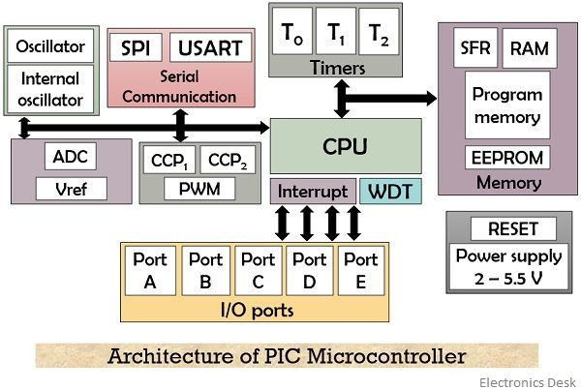
Architecture of PIC Microcontroller

Slide 186
As we have already discussed that it consists of a processor, I/O ports, timers, memory organization etc. in a single chip. So, let us move further and understand the operation of each component of the PIC microcontroller.
CPU: CPU is the central processing unit that has ALU, CU, MU within it. The ALU performs arithmetic and logic operations according to the instructions received. The memory unit stores the instructions that are to be processed and also the data and instruction after being processed.
While the control unit controls the I/O devices connected to the system. As it is based on RISC architecture i.e., reduced instruction set computer, then it is to be noteworthy here that:
The number of instructions is small approximately around a total of 35 instructions, Due to less number of instructions, the operation performed by the CPU will be quite fast, Processing of the instruction takes less time as the length of the instructions is small, RISC architecture also supports less complex compilation and easy debugging.

Slide 187
Memory: Basically there exist two types of memory in PIC microcontroller-
1.Program or code memory: As the name itself is suggesting that program memory holds the set of instructions that are desired to be performed by the microcontroller. It is basically referred as ROM. The memory space provided by this is 8K Χ 14 bits that can store 13-bit instruction or program. The PC accesses the program memory, and increments itself after fetching an instruction.
EEPROM: ROM allows the program to be stored only once. But EEPROM i.e., electrically erasable programmable read only memory permits the multiple times writing of the code on the ROM.
Flash memory: Flash memory is another PROM for this microcontroller. The program in the flash memory can be erased as many times as required.
2.Data memory: Data memory stores the data in it. Basically these are Random Access Memory i.e., RAM. It stores the data on a temporary basis in the registers. PIC microcontroller holds 368 bytes of RAM which is divided into banks. The register were the data is stored are classified as:

Slide 188
General Purpose register: These are the registers that perform the general functions. Like addition, subtraction, multiplication etc. and further storing the results in other register. Hence no special function is assigned to these registers, the PIC holds the ability to directly access the data present in these registers.
Special Purpose register: It is abbreviated as SFR. These registers are assigned some special functions by the processor and hence are not used for any general purpose. The operation to be performed by these registers are already set when the system is manufactured. Hence the functions of these registers are not variable. Some important special function registers are:
STATUS register
TRIS register
PORT register
Like, the function of the STATUS register is to show the status of the program being performed.

Slide 189
I/O ports: The number I/O ports is different for different PIC series. The PIC16 series has 5 I/O port. These are port A, port B, port C, port D and port E.
Bus: Bus in this microcontroller is used to communicate between different units within it. PIC has 2 types of buses, data bus and address bus.
The data bus transfers the data between memory and I/O unit. Whereas the address bus holds the address of the location to/ from where the data is loaded or fetched.
Stack: As the priority of interrupts are higher. Thus whenever, an interrupt is generated then the processor of the PIC microcontroller must switch to handle the interrupt by stopping the operation which is being executed currently. So, the stack stores the address of the program currently being in execution, until the PIC microcontroller handles the generated interrupt.
Once the interrupt handling is done, then the processor switches back to the main program whose address is stored in the stack.
Timers: PIC microcontroller consists of 3 timers. Out of the 3, 2 timers i.e., timer 0 and timer 2 are of 8-bit each while timer 1 is of 16 bit.

Slide 190
Advantages of PIC Microcontroller
The basis of PIC microcontroller is RISC architecture thus operates faster.
It offers easy interfacing of analog device.
It exhibits lower power consumption.
Disadvantages of PIC Microcontroller
Less number of instructions increases the length of the program.
It holds only a single accumulator.
Basically there exist 4 family of PIC microcontroller. Here, in this article we have provided a generalized view of PIC microcontrollers and not of any specified family.

Slide 191
Software Installation (MP Lab IDE, Compiler, Programmer).

Slide 192
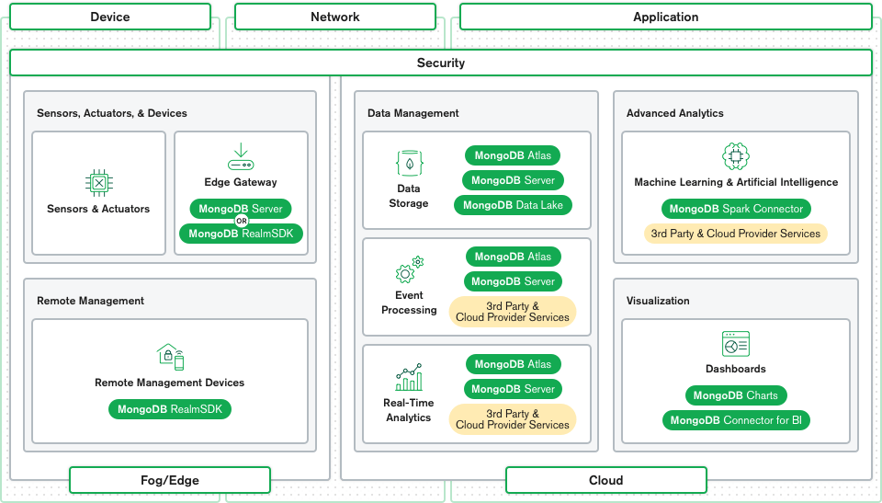

Slide 193
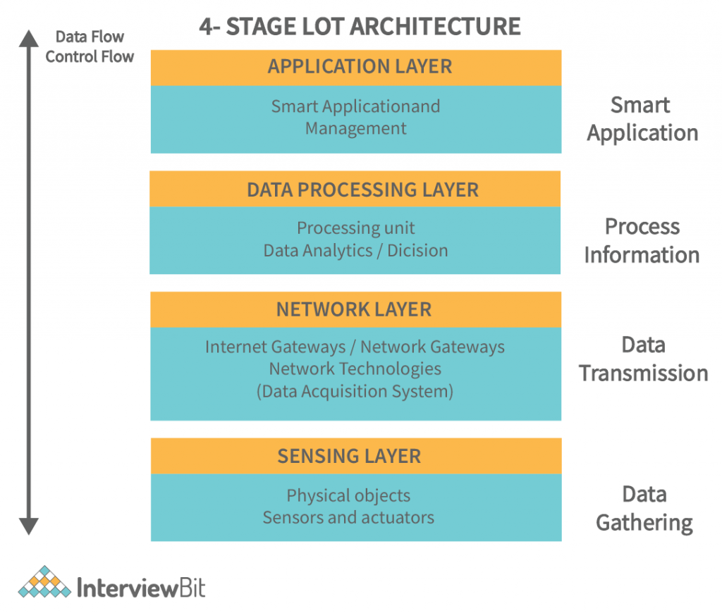

Slide 194
Data Link Communication Protocol
The IoT Data Link communication protocol provides service to the Network Layer. There are various protocols and standard technologies specified by the different organization for data link protocols.
Bluetooth
Bluetooth is a short-range wireless communication network over a radio frequency. Bluetooth is mostly integrated into smartphones and mobile devices. The Bluetooth communication network works within 2.4 ISM band frequencies with data rate up to 3Mbps.
There are three categories of Bluetooth technology:
Bluetooth Classic
Bluetooth Low Energy
Bluetooth SmartReady
The features of Bluetooth 5.0 version is introduced as Bluetooth 5 which have been developed entirely for the Internet of Things.
Properties of Bluetooth network
Standard: Bluetooth 4.2
Frequency: 2.4GHz
Range: 50-150m
Data transfer rates: 3Mbps

Slide 195
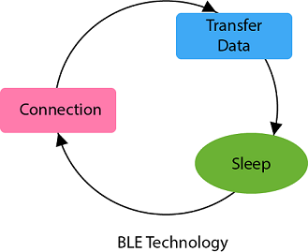
Advantages of Bluetooth network
It is wireless.
It is cheap.
It is easy to install.
It is free to use if the device is installed with it.
Disadvantages of Bluetooth network
It is a short-range communication network.
It connects only two devices at a time.
Bluetooth Low Energy
Bluetooth low energy (BLE) is a short-range communication network protocol with PHY (physical layer) and MAC (Medium Access Control) layer. It is designed for low-power devices which uses less data. BLE always remain in sleep mode except when the connection between devices is initiated and data transmission occurs, due to this it conserves power of the device. Bluetooth low energy follows the master/slave architecture and offers two types of frames that are adverting and data frames. Slave node sent the advertising frame to discover one or more dedicated advertisement channels. Master nodes sense this advertisement channels to find slaves and connect them.

Slide 196
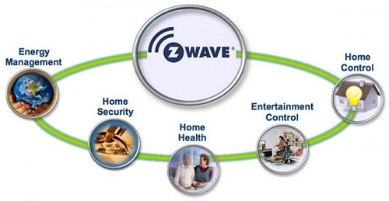
Z-Wave
Z-Wave is a wireless communication protocol with the frequency of 900MHz. The ranges of Z-Wave lies between 30 meters to 100 meters with the data transfer rate of 100kbps so that it is suitable for small messages in IoT applications for home automation. This communication protocol operates on mesh network architecture with one and several secondary controllers.

Slide 197
Properties of Z-Wave protocol
Standard: Z-Wave Alliance ZAD12837 / ITU-T G.9959
Frequency: 908.42GHz
Range: 30-100m
Data transfer rate: 100kbps
Advantages of Z-Wave protocol
Low power consumption
Remote or local control
Simple installation
Interoperability
Application of Z-Wave protocol
Smart product and IoT based application
Energy saving
Home security

Slide 198
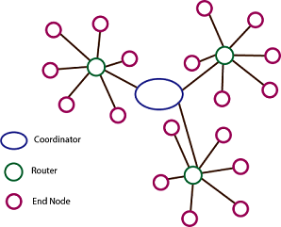
ZigBee Smart Energy
ZigBee is a low power, low data rate wireless personal area network communication protocol. It is mostly used in home automation and industrial settings. Since ZigBee is a low power communication protocol, the IoT power devices used with ZigBee technology. The ZigBee communication protocol is based on the IEEE 802.15.4 standard operating at the 2.4GHz frequency. The ZigBee protocol supports star, cluster or wireless mesh technology topology.
ZigBee uses the following devices in its network:
Zigbee Coordinator
Zigbee End Device
Zigbee Router

Slide 199
Properties of ZigBee protocol
Standard: ZigBee 3.0 based on IEEE802.15.4
Frequency: 2.4GHz
Range: 10-100m
Data transfer rate: 250kbps
Advantages of ZigBee protocol
Wireless
Mesh networking
Direct communication
Low power consumption
Disadvantages of ZigBee protocol
Costly
Works with low speed within a small distance
Application of ZigBee protocol
Commercial and residential control
Personal and healthcare
Home networking
Industrial control and management
Consumer electronics

Slide 200
LoRaWAN
LoRaWAN refers to Long Rage Wide Area Network which is a wide area network protocol. It is an optimized low-power consumption protocol design to support large-scale public networks with millions of low-power devices. A single operator operates the LoRaWAN. The LoRaWAN network is a bi-directional communication for IoT application with low cost, mobility, and security.
Properties of LoRaWAN protocol
Standard: LoRaWAN
Frequency: Various
Range: 2-5km (urban environment), 15km (suburban environment)
Data Rates: 0.3-50 kbps.

Slide 201
Serial & Parallel Communication
Computer transfer data in two different ways:-
Serial transfer: In serial transfer, data is transfer to device located many meters away this method is used for long distance data transfer.
Let's see the block diagram of serial data transfer:
Parallel transfer: In parallel transfer, data is transferred in 8 or more lines. In this wire conductor is used for transferring data to a device that is only a few feet away.
Let's see the block diagram of parallel data transfer:

Slide 202
Serial communication is mostly used for transmitting and receiving the signal. The 8051 microcontroller is consisting of Universal Asynchronous Receiver Transmitter (UART) used for serial communication. The signals are transmitted and received by the Rx and Tx pins of microcontroller.
The UART take individual bytes of data and sends the individual bits in a sequential manner. The registers are used for collecting and storing the data inside a memory. UART is based on half-duplex protocol. Half-duplex means transferring and receiving the data, but not at the same time.
Let's see the block diagram representation of showing serial communication between flash memory and 8051 microcontroller:

Slide 203
Types of Transmission
The transmission mode is a computer network process in which data or information is transmitted between two devices over the network. We can also say that it is a mechanism that transfers data in electromagnetic bits format between two devices that are connected through network. It is also known as communication mode.
The transmission mode defines the direction of the flow of the data. For example, a sender wants to send data to a particular receiver, then the sender can send information to a receiver using transmission mode over the network.

Slide 204
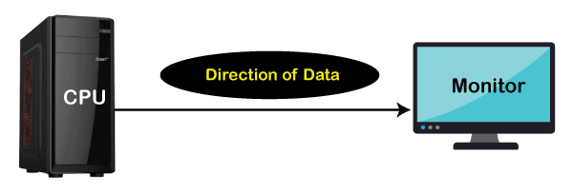
Transmission Modes
There are following three types of transmission modes .in network.
Simplex Mode
Half duplex Mode
Full duplex Mode
Simplex Mode
It is a basic mode of transmission that enables the transmission of data only in one direction. When the data is transferring to the other side, the other person can only receive the data but cannot respond to the message at the same time. Simplex mode is also called a unidirectional mode. The examples of simplex mode are keyboard, monitor, television, and radio etc.

Slide 205
Advantage of Simplex Mode:
It uses the full capacity of bandwidth during transmission of data due to single directional.
There are no traffic issues occur during communication.
Disadvantage of Simplex Mode:
Transmission of data in only one direction weaker the performance of simplex mode.
Two devices cannot communicate with each other in at the same time.
Bidirectional transmission is not occurring in the simplex mode.

Slide 206

Half Duplex Mode
Half-duplex mode transfers data in both directions but not at the same time. We can also say it is a way of communication in which sender sends the information to the receiver, and the receiver can receive the information. After receiving the information, the receiver can respond to the sender. The walkie talkie is the best example of half duplex mode. In this device, when the sender completes his message speaks over and out which indicates that the receiver can responds to the message now.

Slide 207
Advantage of Half Duplex Mode:
It is a two-dimensional model of transmission of the data.
In half-duplex mode, data can be received or sent from both directions but only one at a time.
The transmission of data is easy as compared to the simplex mode.
It requires less complicated hardware.
There is less congestion in the network.
Disadvantage of Half Duplex Mode:
When one device sends data to another device, the second one must wait for that may cause delays in receiving the output.
Slow in the transmission of data.
The speed of half-duplex mode is slower than the full-duplex mode of transmission.
Data cannot simultaneously send or receive by the sender and the receiver.

Slide 208
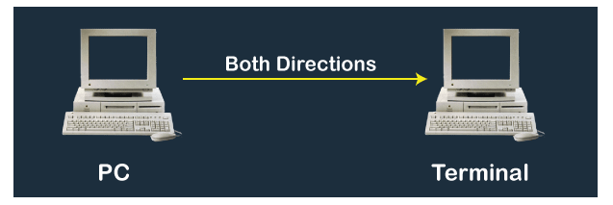
Full Duplex Mode
Full-duplex mode allows the transmission of data between the two devices at the same time. It is also known as a bidirectional mode. The sender and receiver can simultaneously send and receive the data over a network. For example, in a telephonic conversation, two people can talk and listen simultaneously at the same time.

Slide 209
Advantage of Full Duplex Mode:
The performance of a full-duplex transmission mode is much higher than the simplex and the half-duplex mode.
The bandwidth of full-duplex mode is double during the transmission of the data.
Both devices can send or receive the data simultaneously.
There is no delay in transmitting data over the network.
Disadvantage of Full Duplex Mode:
In full-duplex mode, there can be a traffic problem while transmitting the data on a network.
There is no proper utilization of bandwidth in full-duplex mode while sending

Slide 210
Simplex Vs. Half Duplex Vs. Full Duplex Mode
Simplex Mode | Half Duplex Mode | Full Duplex Mode
It is a unidirectional mode of transmission in which the flow of data only in one direction. | It is a bidirectional mode of transmission in which data flows in two ways but one at a time. | It is also a two-way or bidirectional mode of transmission in which data flows in two ways at the same time.
One sender can only send data, but the other end-user cannot respond. | Both can send and respond to information but not at the same time. | Both can simultaneously send or receive messages on the same network at the same time.
The performance of the simplex mode is slow as compared to Half and Full-Duplex mode of transmission. | Half-duplex mode performance is higher than simplex mode but slower than full-duplex. | The performance of full-duplex mode is much higher than both simplex and half-duplex mode.
The bandwidth usage is maximum. | The bandwidth usage during data transmission is low. | The bandwidth usage during data transmission is double.
Example: monitor, radio, keyboard, mouse and the television. | Example: walkie-talkie. | Example: telecommunication, mobile, etc.

Slide 211
What is UART?
UART is an abbreviation for "Universal asynchronous receiver/transmitter". It is a large integration device that is designed to deal with the transmission of sequential data. It stands in the middle between systems that handle data in a parallel structure and those that process it in an unusual sequential structure. UART has a slower data transfer rate than UART. No approaching clock signal is associated with the data, so the recipient must know the transmitter's baud rate before gathering. The microcontroller generates the data clock in UART, which is synchronized with the data stream via a start-bit transition.
Features of the UART
There are various features of the UART. Some main features of the UART are as follows:
It generates a clock internally and synchronizes the data stream with it via the start-bit transition.
The start and stop bits are utilized to detect errors between data words and parity bits.
In these devices, the receiver is also informed of the transmitter's baud rate before initiating communication.
RS232 is another name for UART.

Slide 212
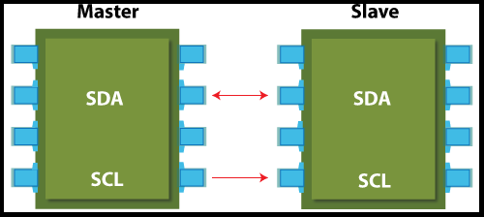
I2C Protocol
The I2C stands for the inter integrated controller. The I2C protocol is a serial communication protocol that is used to connect low-speed devices. For example, EEPROMs, microcontrollers, A/D and D/A converters, and input/output interfaces. It was developed by Philips semiconductor in 1980 for inter-chip communication. Almost all major IC manufacturers now use it. It is a master-slave communication in which you can connect and control multiple slaves from a single master. In this, each slave device has a particular address. It supports various data rates according to versions ranging from 100 Kbps, 400 Kbps, 1 Mbps to 3.4 Mbps. It is synchronous communication like SPI.
I2C interface
I2C protocol uses only two cables for the communication in which one cable is used for the data (SDA), and another cable is used for clock (SCL). Both cables are required to pull up with a resistor for + Vdd. It can be used to link two I2C buses with different voltages.

Slide 213
Applications of I2C
It is the best choice for those applications that require less costly and easy implementation rather than high-speed.
Reading certain memory ICs
Accessing DACs and ADCs
Transmitting and controlling user-directed actions
Reading hardware sensors
Communicating with multiple micro-controller
Advantages of I2C
There are the following advantages:
It provides flexible data transmission rates.
It provides long-distance communication than SPI.
Each device on the bus is controlled independently.
It increases the complexity of firmware or low-level hardware.
This protocol imposes overhead that also reduces throughput.
This protocol requires only two cables.
It can accommodate several master interactions through arbitration and collision detection.

Slide 214
Disadvantages of I2C
The complexity of hardware increases when no. of master/slave devices are high in the circuit.
It provides a half-duplex mode for communication.
It is managed by the stack.
Many devices have multiple addresses stored, which can cause conflicts.

Slide 215
Tinkercad Tasks
Make led blink.
Make Diwali pattern lights with led.
How to control brightness of the led.
Print and 0 to 9 on Seven segment display.
Print hello world on lcd.
Interface DC geared motor with Arduino via motor driver chip
Write a program to control clockwise and anticlockwise movement of motor.
Interface DHT11 with Arduino and write a program to print its output on Serial monitor.
Write a program to turn on LED when room temperature is above 30 degrees and turn it off otherwise.
Interface Ultrasonic sensor with Arduino and write a program to print its output on Serial monitor.
Write a program to turn on BUZZER when distance measured by ultrasonic from the obstacle is less than 30 cm and turn it off otherwise.
Interface IR(Infrared) sensor with Arduino and write a program to print its output on Serial monitor.
Write a program to turn on buzzer when IR sensor detects an obstacle and turn buzzer off when no obstacle is detected.
Serial communication protocols:- ADC,DAC,I2C,UART,SPI,RS485,DMA,ETHERNET,SD/eMMC,SDIO,UFS

